Slide 1
The following PowerPoint is taken from a junior camp sermon series by Bob Roberts preached at the Wilds Christian Camp during the summer of 2022.
Find full Bible study posts from this series and more resources at reflectingthedesigner.com.
Email questions to info@reflectingthedesigner.com

Slide 2
Miracle #7
Jesus Raises Lazarus from the Dead
John 11

Slide 4
John 11
39) [In Bethany] Jesus said, Take ye away the stone. Martha, the sister of him that was dead, saith unto him, Lord, by this time he stinketh: for he hath been dead four days.
40) Jesus saith unto her, Said I not unto thee, that, if thou wouldest believe, thou shouldest see the glory of God?
41) Then they took away the stone from the place where the dead was laid. And Jesus lifted up his eyes, and said, Father, I thank thee that thou hast heard me.

Slide 5
John 11
42) And I knew that thou hearest me always: but because of the people which stand by I said it, that they may believe that thou hast sent me.
43) And when he thus had spoken, he cried with a loud voice, Lazarus, come forth.
44) And he that was dead came forth, bound hand and foot with graveclothes: and his face was bound about with a napkin. Jesus saith unto them, Loose him, and let him go.
53) Then from that day forth they [the Pharisees] took counsel together for to put him to death.

Slide 6
What Happened Next?
Just a few short hours after raising Lazarus from the dead the Jews began preparing for the week of Passover Feast.
Thousands of lambs were being brought into the city for Passover sacrifice but only One Lamb that could take away the sins of the world would enter Jerusalem!
But the triumphal entry cheers quickly changed from “Hosanna” to “Barabbas” as Christ was betrayed and sentenced to death by crucifixion.

Slide 7
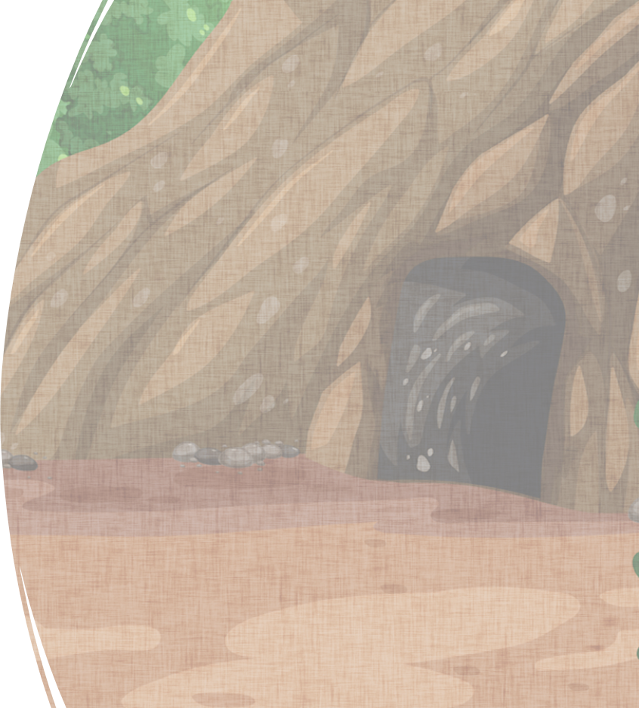
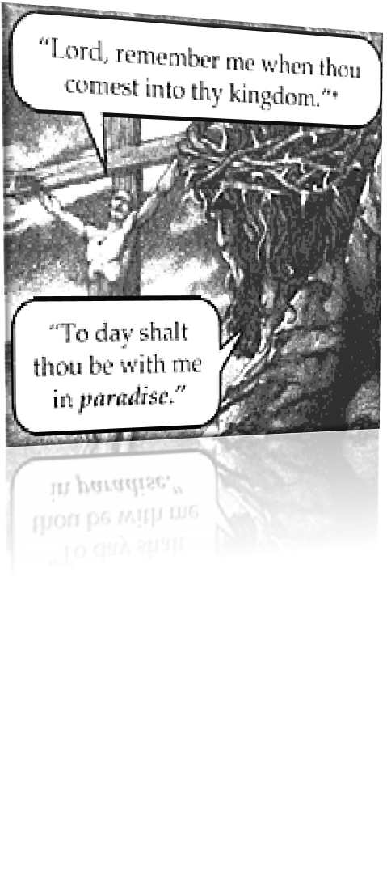
Philippians 3:9
And be found in him, not having mine own righteousness, which is of the law, but that which is through the faith of Christ, the righteousness which is of God by faith.

Slide 8
Jesus Took My Rightful Punishment
Jesus took our place on the cross. He paid the penalty for all our sin. Jesus died so that we might have life! But Jesus did NOT stay dead!
He rose again the third day. (1 Corinthians 15:4)
O death, where is thy sting? O grave, where is thy victory? (1 Corinthians 15:55)
Jesus is the only one who can rescue us from sin and sin’s penalty, because He won the victory over sin by rising from the dead. He is the living Savior.

Slide 9
Christ’s Resurrection Gave The Early Church Radical Confidence
Because if Christ could beat death for Himself, surely He could also beat it for them!
Peter was crucified upside down and Mathias was beheaded. The only one of the disciples that did not die an early martyr's death was John! He lived to be a very old man.
The first recorded martyr in Scripture is Stephen. And I think it’s amazing how that Stephen’s life is so united with Christ’s.

Slide 10
Stephen Was Like His Savior…
“…full of the Holy Ghost.”
And Stephen, full of faith and power, did great wonders and miracles among the people. (Acts 6:8)
Ye stiffnecked and uncircumcised in heart and ears, ye do always resist the Holy Ghost: as your fathers did, so do ye. Which of the prophets have not your fathers persecuted? and they have slain them which shewed before of the coming of the Just One; of whom ye have been now the betrayers and murderers. (Acts 7: 51-52)
And they stoned Stephen, calling upon God, and saying, Lord Jesus, receive my spirit. And he kneeled down, and cried with a loud voice, Lord, lay not this sin to their charge. And when he had said this, he fell asleep. (Acts 7:59-60)

