Slide 1
The following PowerPoint is taken from a junior camp sermon series by Bob Roberts preached at the Wilds Christian Camp during the summer of 2022.
Find full Bible study posts from this series and more resources at reflectingthedesigner.com.
Email questions to info@reflectingthedesigner.com

Slide 2
Miracle #6
Jesus Made the Blind Man See
John 9:1-41

Slide 4
John 9
1) And as Jesus passed by, he saw a man which was blind from his birth.
2) And his disciples asked him, saying, Master, who did sin, this man, or his parents, that he was born blind?
3) Jesus answered, Neither hath this man sinned, nor his parents: but that the works of God should be made manifest [displayed] in him.

Slide 5
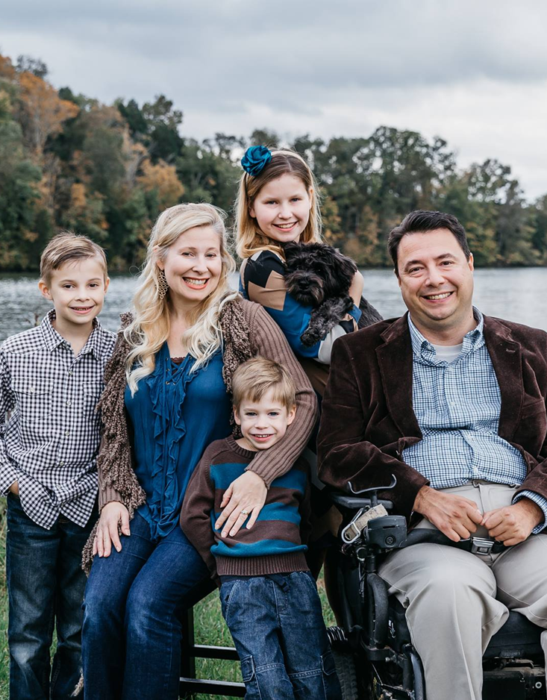
Pastor Bobby McCoy
“He is in complete control of all circumstances. God works all things for our good and His glory.
Since my accident, God has indeed been faithful to me. He helped me with my rehabilitation, He made it possible for me to marry my fiancée, He helped me complete graduate school, and He has provided me with the opportunity to serve Him in full time ministry even though I am in a wheelchair. What seemed to be a tragedy has been part of the equipping process so that I can better serve God. He will do the same for you!”

Slide 6
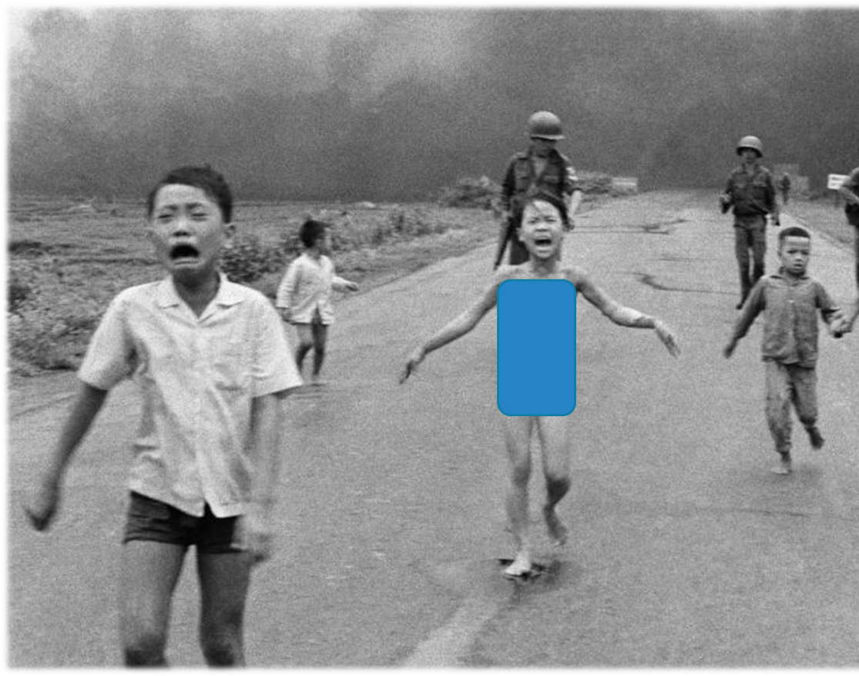
Phan Thi Kim “Napalm Girl”

Slide 7
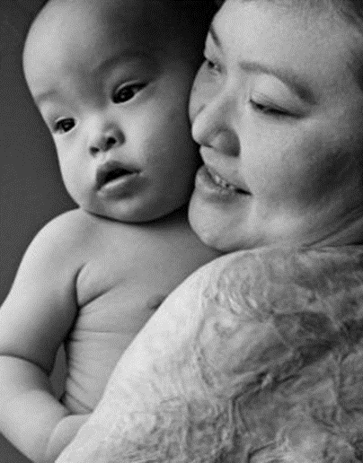
"But even worse than the physical pain was the emotional and spiritual pain." This led directly to her conversion to Christianity, which she credits with healing the psychological trauma of living over forty years being known to the world as "Napalm Girl". "My faith in Jesus Christ is what has enabled me to forgive those who had wronged me," she wrote, "no matter how severe those wrongs were."
“Forgiveness made me free from hatred. I still have many scars on my body and severe pain most days but my heart is cleansed. Napalm is very powerful, but faith, forgiveness, and love are much more powerful.”

Slide 8
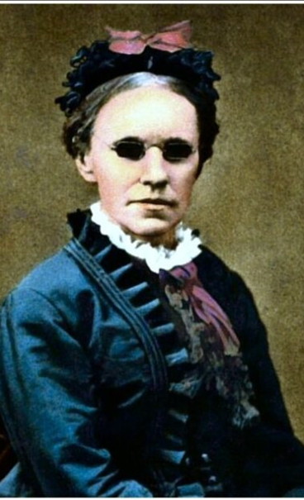
Fanny Crosby Wrote over 8,000 Hymns
"It seemed intended by the blessed providence of God that I should be blind all my life, and I thank him for the dispensation. If perfect earthly sight were offered me tomorrow, I would not accept it. I might not have sung hymns to the praise of God if I had been distracted by the beautiful and interesting things about me."
“When I get to heaven, the first face that shall ever gladden my sight will be that of my Savior."

Slide 9
John 9
5) As long as I am in the world, I am the light of the world.
6) When he had thus spoken, he spat on the ground, and made clay of the spittle, and he anointed the eyes of the blind man with the clay,
7) And said unto him, Go, wash in the pool of Siloam, (which is by interpretation, Sent.) He went his way therefore, and washed, and came seeing.

Slide 10
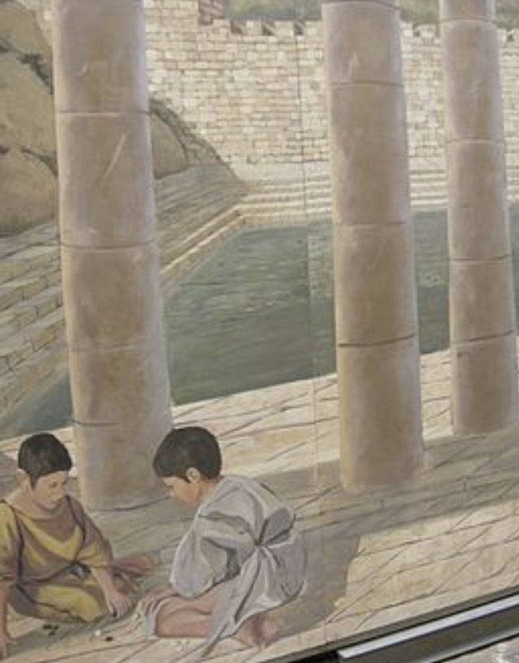
Pool of Siloam
As for the other events of Hezekiah’s reign, all his achievements and how he made the pool and the tunnel by which he brought water into the city, are they not written in the book of the annals of the kings of Judah? (2 Kings 20:20) See also 2 Chronicles 32:1-4
The Pool of Siloam was created during the reign of King Hezekiah about 750 years before Christ!
There was an elaborate underground tunnel system that directed the Spring of Gihon into the Pool of Siloam.

Slide 11
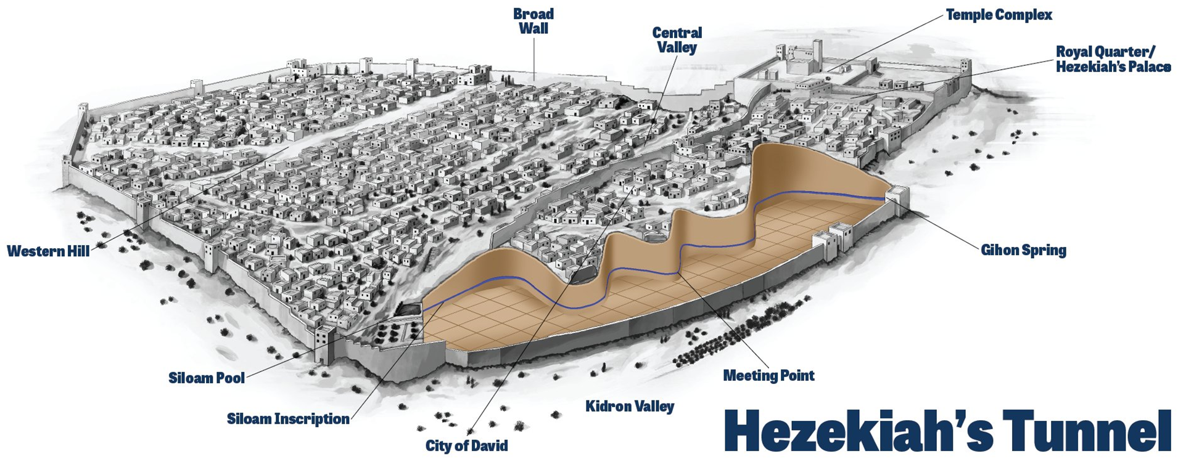

Slide 12
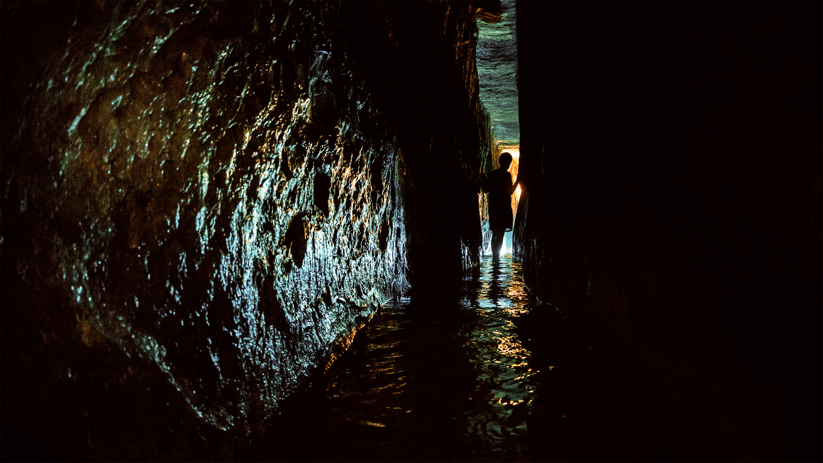

Slide 13
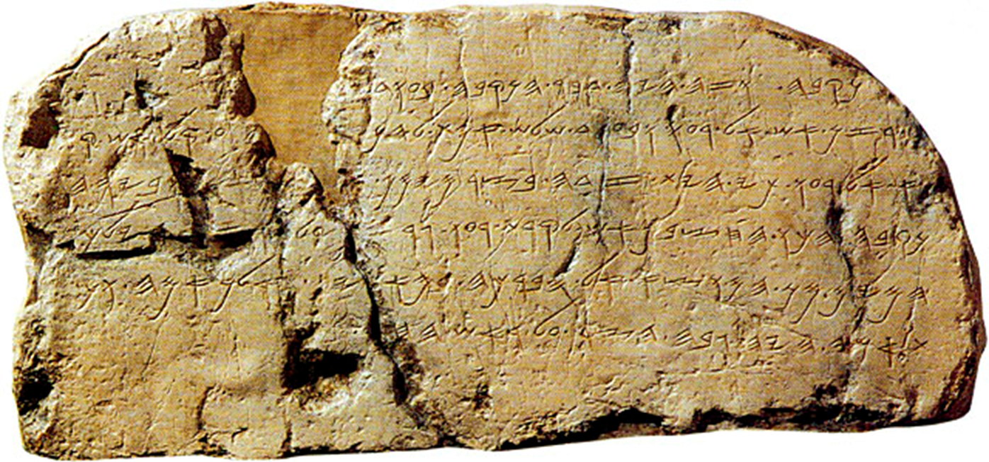
The Siloam Inscription Discovered In 1880 By A 16 Year Old!

Slide 14
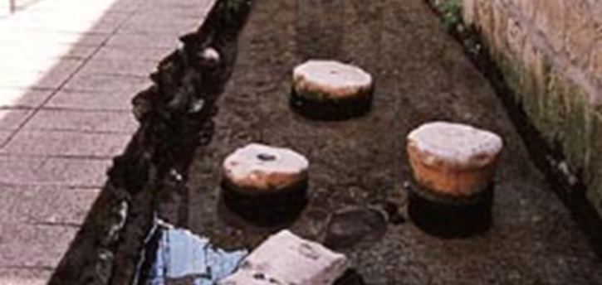
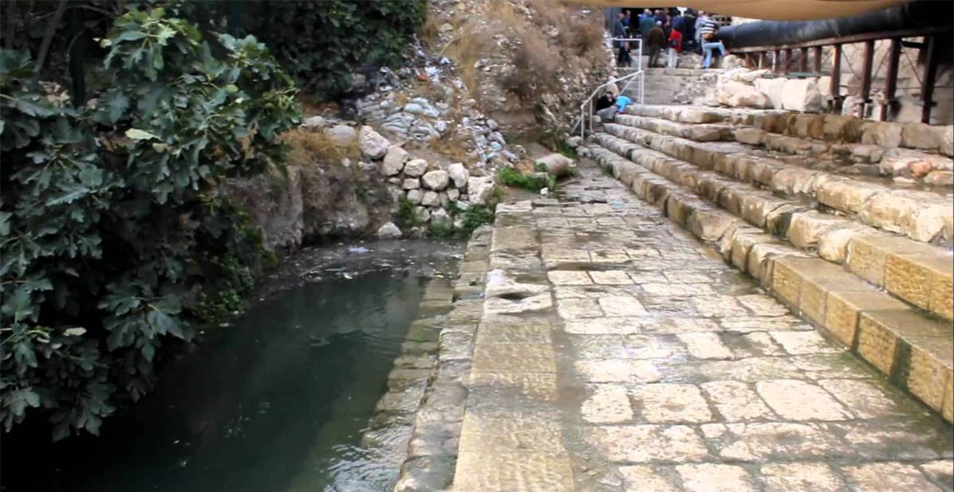
The Pool of Siloam Found in 2004!

Slide 15
John 9
35) Jesus heard that they had cast him out; and when he had found him, he said unto him, Dost thou believe on the Son of God?
36) He answered and said, Who is he, Lord, that I might believe on him?
37) And Jesus said unto him, Thou hast both seen him, and it is he that talketh with thee.
38) And he said, Lord, I believe. And he worshipped him.

Slide 16
Application
Jesus is AWESOME!

Slide 17
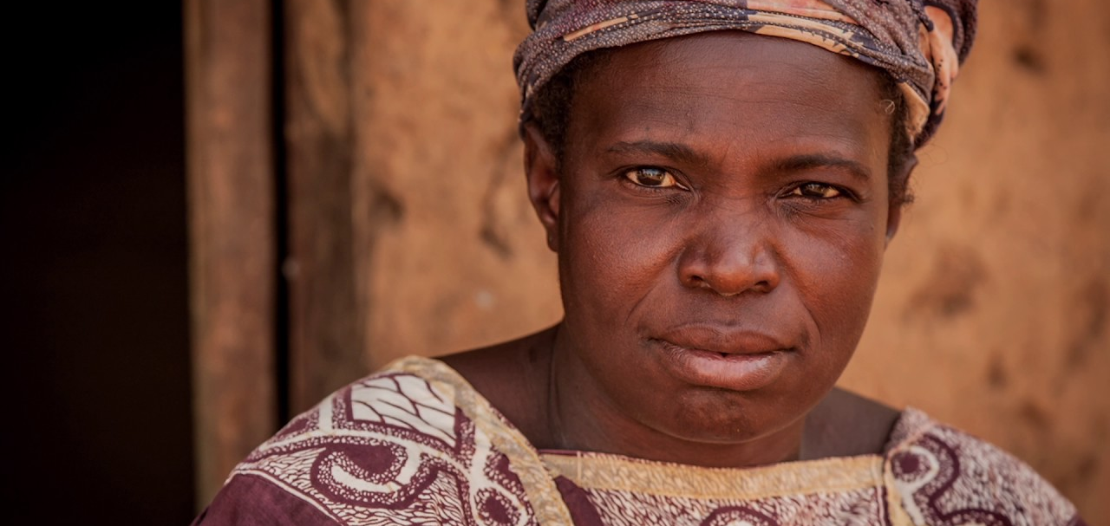
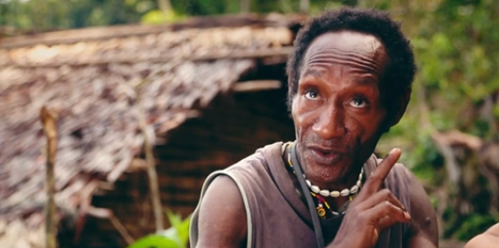
The Mouk People

Slide 18
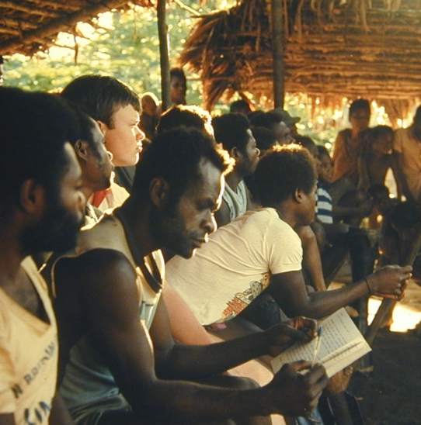
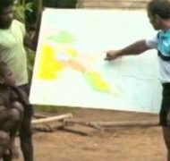
Mark Teaches the Village

Slide 19
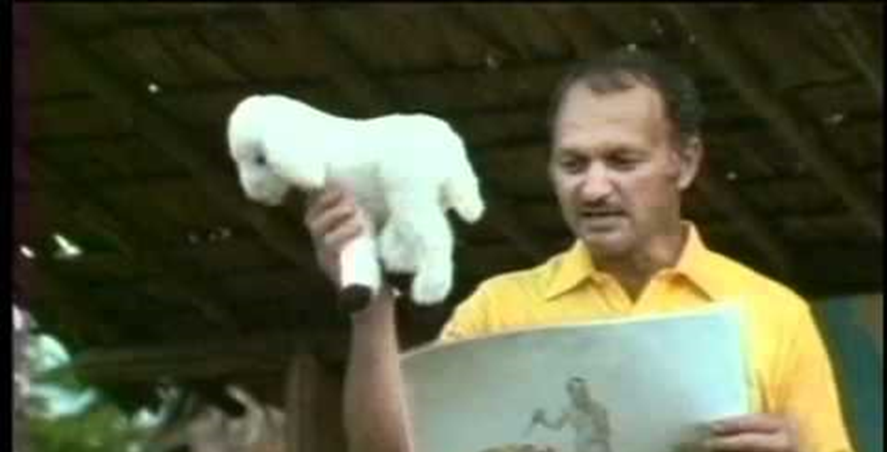

Slide 20
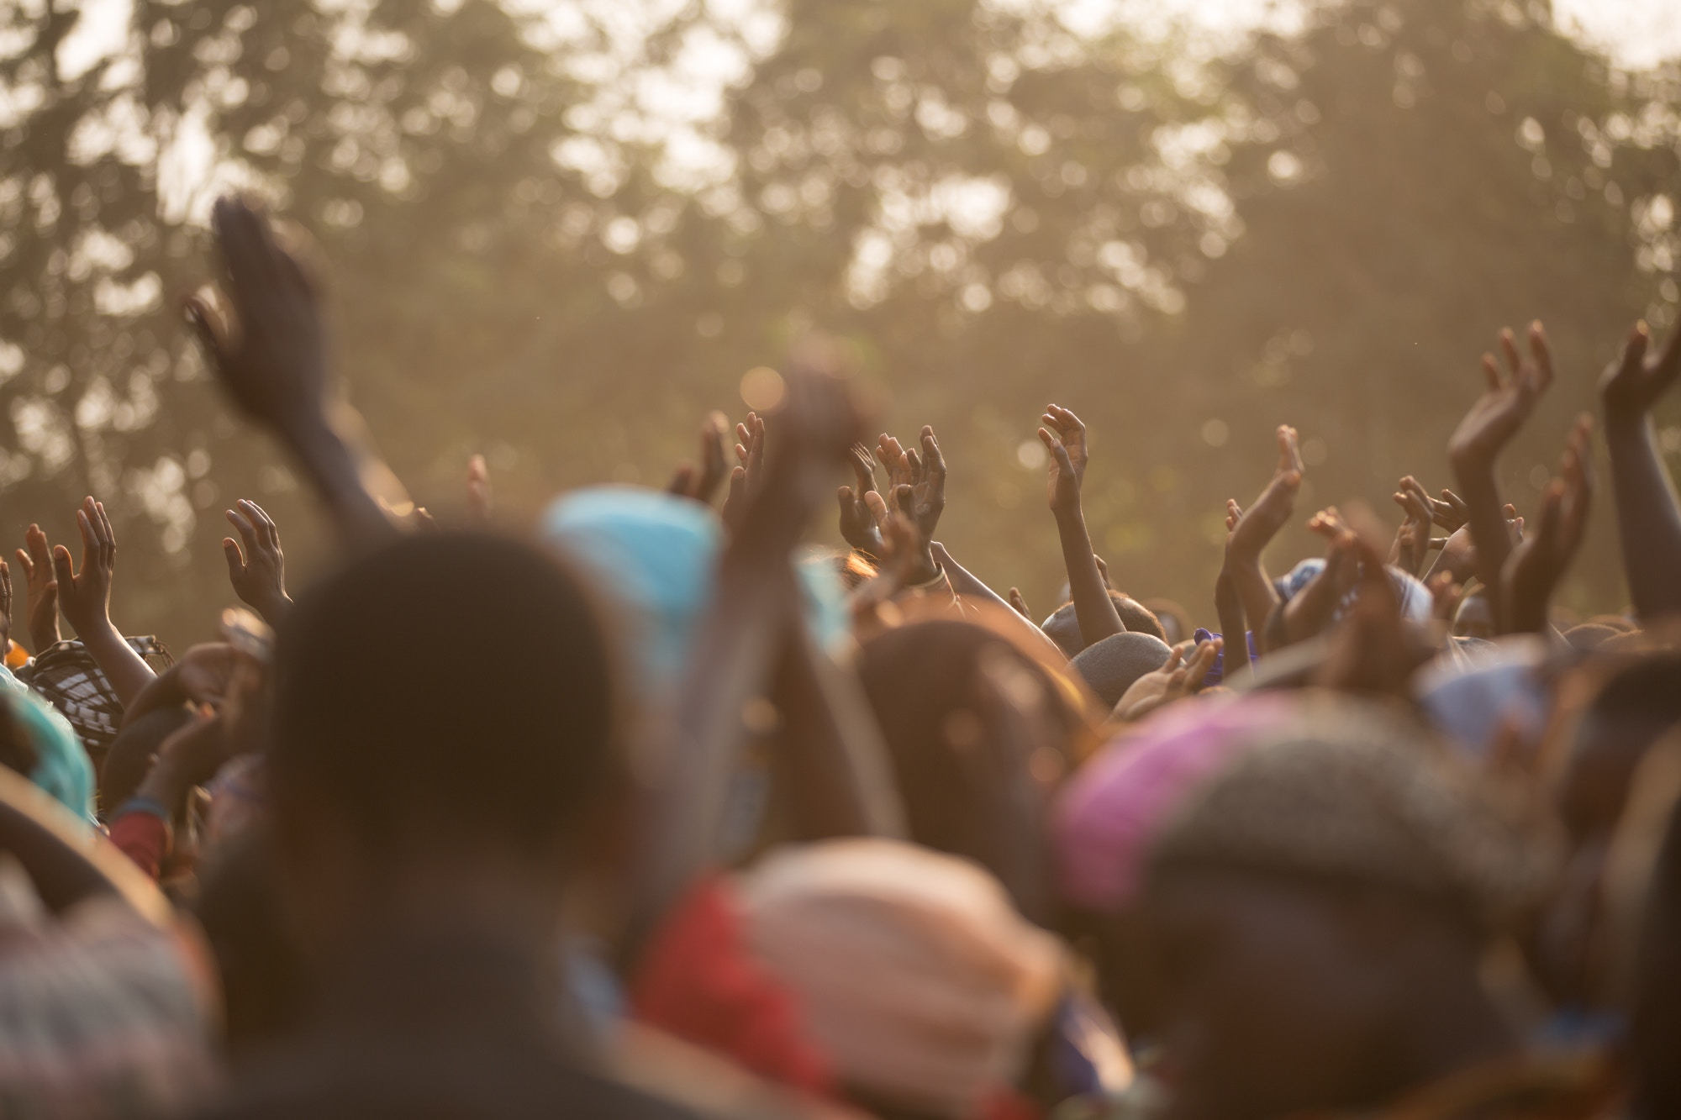
Ee-Taow!

