Slide 1
The following PowerPoint is taken from a junior camp sermon series by Bob Roberts preached at the Wilds Christian Camp during the summer of 2022.
Find full Bible study posts from this series and more resources at reflectingthedesigner.com.
Email questions to info@reflectingthedesigner.com

Slide 2
Miracle #5
Jesus Walks on Water
John 6:16-21

Slide 4
John 6
Happens immediately after the Feeding the Thousands and Thousands…
14) Then those men, when they had seen the miracle that Jesus did, said, This is of a truth that prophet that should come into the world.
15) When Jesus therefore perceived that they would come and take him by force, to make him a king, he departed again into a mountain himself alone.

Slide 5
John 6
16) And when even was now come, his disciples went down unto the sea,
17) And entered into a ship, and went over the sea toward Capernaum. And it was now dark, and Jesus was not come to them.
18) And the sea arose by reason of a great wind that blew.

Slide 6
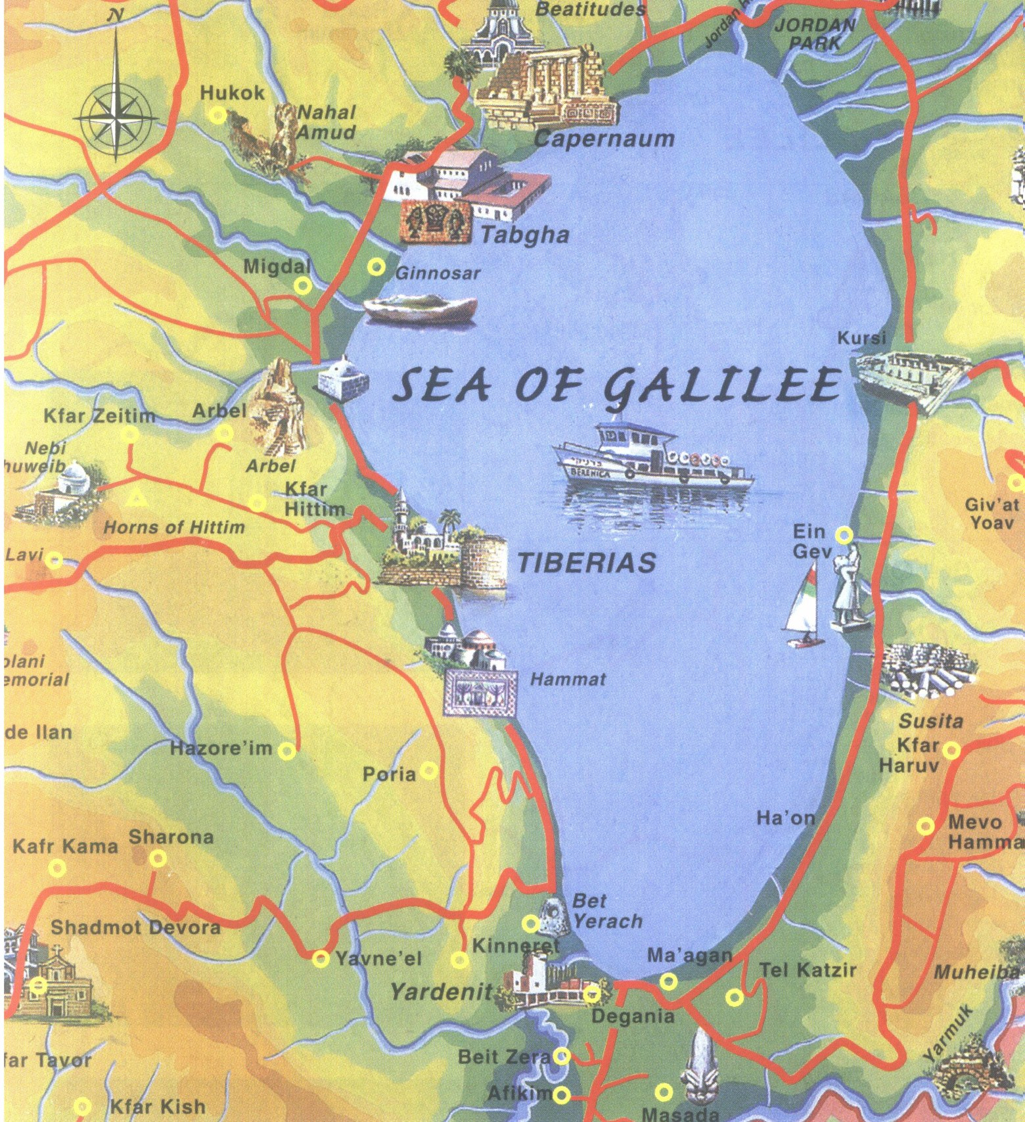
13 miles
8 miles

Slide 8
John 6
19) So when they had rowed about five and twenty or thirty furlongs [about 4 miles], they see Jesus walking on the sea, and drawing nigh unto the ship: and they were afraid.
20) But he saith unto them, It is I; be not afraid.
21) Then they willingly received him into the ship: and immediately the ship was at the land whither they went.

Slide 9
Why Did Jesus Perform This Miracle Just For The Disciples?
For they considered not the miracle of the loaves: for their heart was hardened. (Mark 6:52)
What is the heart? It is who you are at the deepest, realest level. It is what you think, feel, and believe.
Do you know that if the disciples could harden their hearts after seeing so much of God you can too? Do you know why?
The heart is deceitful above all things, and desperately wicked: who can know it? (Jeremiah 17:9)

Slide 10
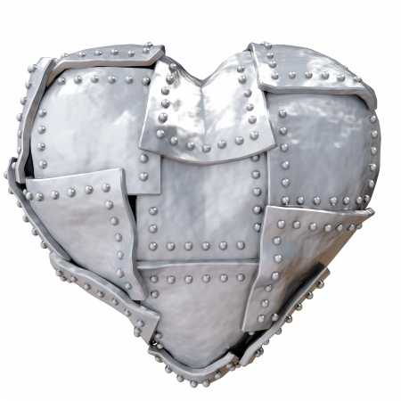
How To Grow A Hard Heart
Don’t guard your heart
Trust in your heart more than God’s Word
Set your heart on things that cannot satisfy

Slide 11
How To Grow A Hard Heart? #1 Don’t Guard Your Heart
Keep thy heart with all diligence; for out of it are the issues of life. (Proverbs 4:23)

Slide 12
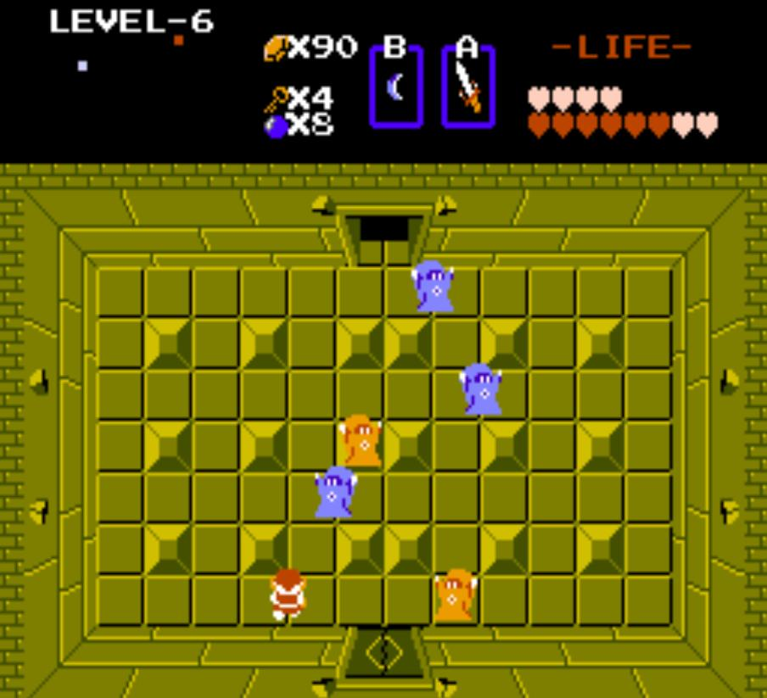

Slide 13
How To Grow A Hard Heart? #1 Don’t Guard Your Heart
Keep thy heart with all diligence; for out of it are the issues of life. (Proverbs 4:23)
Mine eye affecteth my heart. (Lamentations 3:51) [what you see and hear influences you!]

Slide 14
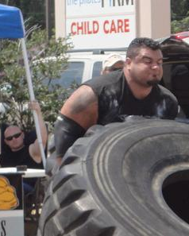
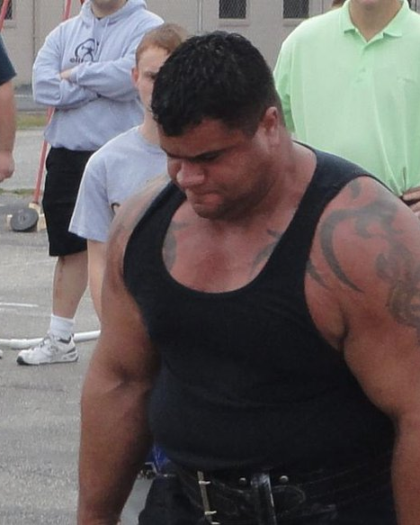

Slide 15
How To Grow A Hard Heart? #1 Don’t Guard Your Heart
Keep thy heart with all diligence; for out of it are the issues of life. (Proverbs 4:23)
Mine eye affecteth my heart (Lamentations 3:51)
And delivered just Lot, vexed with the filthy conversation of the wicked: For that righteous man dwelling among them, in seeing and hearing, vexed his righteous soul from day to day with their unlawful deeds. (2 Peter 2:7-8)

Slide 16
How To Grow A Hard Heart? #2 Trust In Your Heart More Than God’s Word
Neither be ye idolaters, as were some of them; as it is written, The people sat down to eat and drink, and rose up to play. (1 Cor. 10:7)
Idolatry is an attack on God's exclusive rights to our love, trust and obedience.
That which a man chooses for his god, he sets his heart mainly upon. And nothing will so soon excite enmity, as opposition in that which is dearest. A man will be the greatest enemy to him who opposes him in what he chooses for his god. – Jonathan Edwards
Have you ever seen a dog bare its fangs?

Slide 17
How To Grow A Hard Heart? #3 Set Your Heart On Things That Cannot Satisfy
Thou shalt not covet. (Exodus 20:17)
And he said unto them, Take heed, and beware of covetousness: for a man's life consisteth not in the abundance of the things which he possesseth. (Luke 12:15)
Jesus was so kind to continue ministering to those whose hearts were hardened. And the hope is that His character and mercy is still the same as it was when he personally reached hard-hearted disciples with a miracle just for them. Sidenote: Jesus’ ministry to the disciples was very effective, take a look…

Slide 18
John 6
67) Then said Jesus unto the twelve, Will ye also go away?
68) Then Simon Peter answered him, Lord, to whom shall we go? thou hast the words of eternal life.
69) And we believe and are sure that thou art that Christ, the Son of the living God.

