Slide 1
The following PowerPoint is taken from a junior camp sermon series by Bob Roberts preached at the Wilds Christian Camp during the summer of 2022.
Find full Bible study posts from this series and more resources at reflectingthedesigner.com.
Email questions to info@reflectingthedesigner.com

Slide 2
Miracle #4
Jesus Feeds the Thousands
John 6:1-15

Slide 4
The Fourth Miracle
By far the fourth miracle was the most public miracle that impacted the most people. You can’t miraculously feed thousands of people unnoticed!
The fourth miracle is the only miracle to appear in all four gospel accounts.
Other than the resurrection, the fourth miracle is quite possibly the most attacked act that Jesus ever performed.

Slide 5
John 6
5) When Jesus then lifted up his eyes, and saw a great company come unto him, he saith unto Philip, Whence shall we buy bread, that these may eat?
6) And this he said to prove him: for he himself knew what he would do. [#metamoment]
7) Philip answered him, Two hundred pennyworth of bread [half a year’s salary] is not sufficient for them, that every one of them may take a little.

Slide 6
John 6
8) One of his disciples, Andrew, Simon Peter's brother, saith unto him,
9) There is a lad here, which hath five barley loaves, and two small fishes: but what are they among so many?
10) And Jesus said, Make the men sit down. Now there was much grass in the place. So the men sat down, in number about five thousand.

Slide 7
How Many People?
We know that there were 5,000 men. But two of the other gospels help us to understand this number did not include women and children.
So let’s do some conservative math! Let’s say there was only 2,500 women and 2,500 children. That is 10,000 people. Jesus went viral before the internet!

Slide 8
How Many People?
But there was probably just as many women as men and probably twice as many children:
5,000 men
5,000 women
10,000 children = approximately 20,000 souls!
How could He do this?

Slide 10
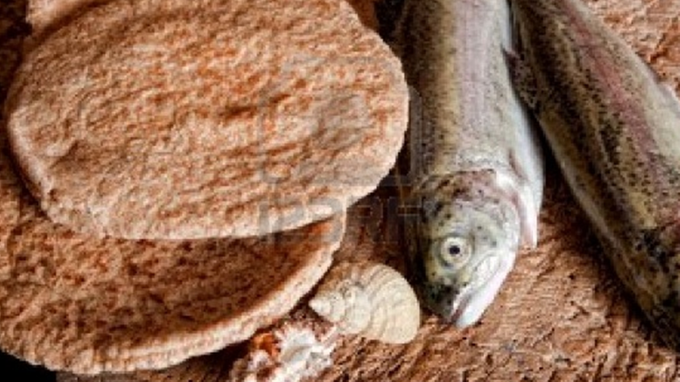
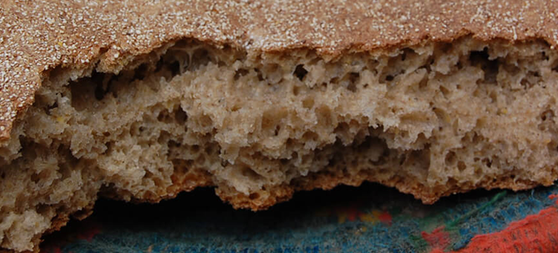
Barley Loaves or Wafers were known as “poor people food”
Each loaf or wafer was about the size of a modern pocket of pita bread.

Slide 11
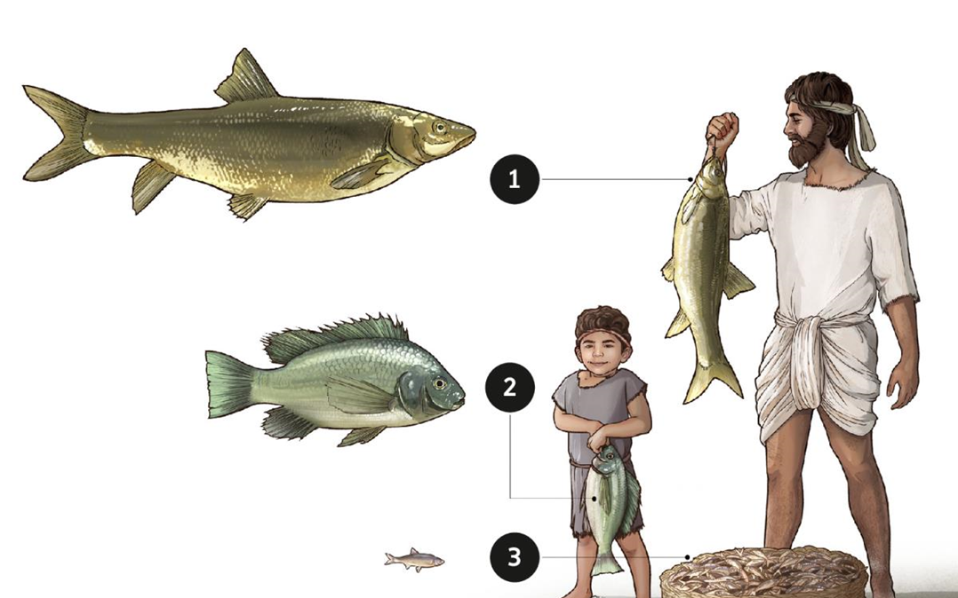
Carp
Tilapia
Kinneret Sardines

Slide 12
St. Peter’s Fish
Not Yummy.

Slide 13
John 6
11) And Jesus took the loaves; and when he had given thanks, he distributed to the disciples, and the disciples to them that were set down; and likewise of the fishes as much as they would.
12) When they were filled, he said unto his disciples, Gather up the fragments that remain, that nothing be lost.
13) Therefore they gathered them together, and filled twelve baskets with the fragments of the five barley loaves, which remained over and above unto them that had eaten.

Slide 14
Isn’t It Amazing?
When 2 little fish and 5 little loaves were given to the Master something amazing happened. He did something so BIG with something so SMALL.
Imagine if you brought your time, talents, and treasures to the Master. Imagine if you just gave your whole life to the Master.
Are you wasting your life or investing your life? Are you saving your life or spending your life? He that findeth his life shall lose it: and he that loseth his life for my sake shall find it. (Matthew 10:39)
American Dream or Gospel Mission?

Slide 15
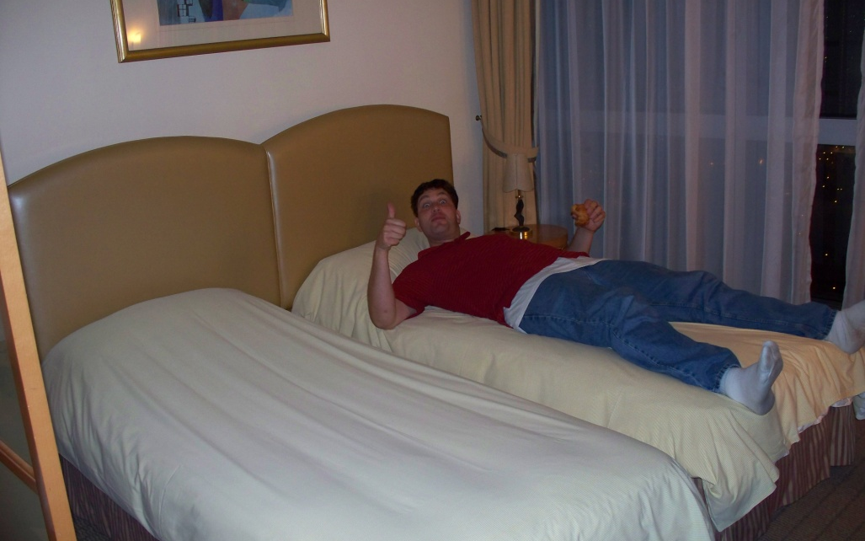

Slide 16
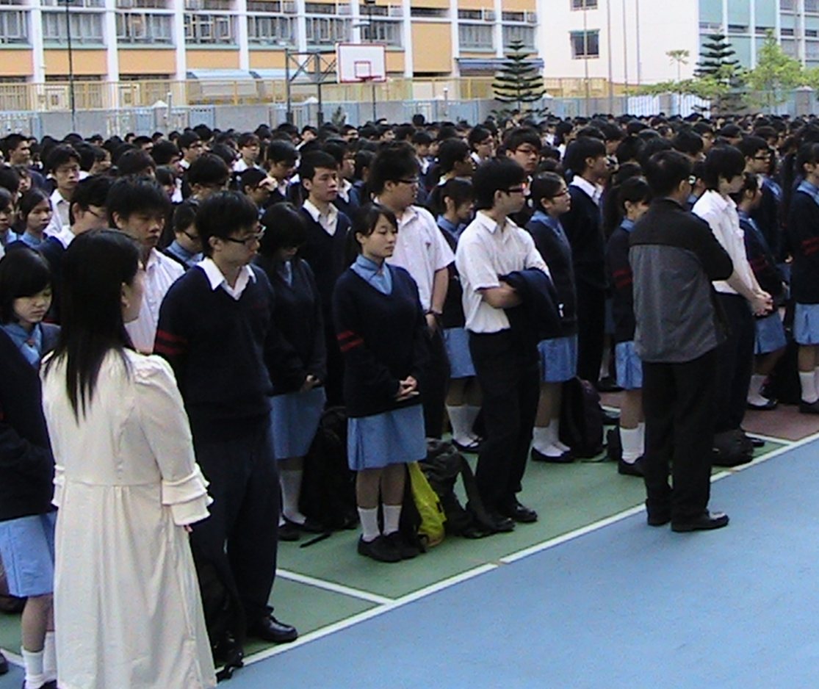

Slide 17
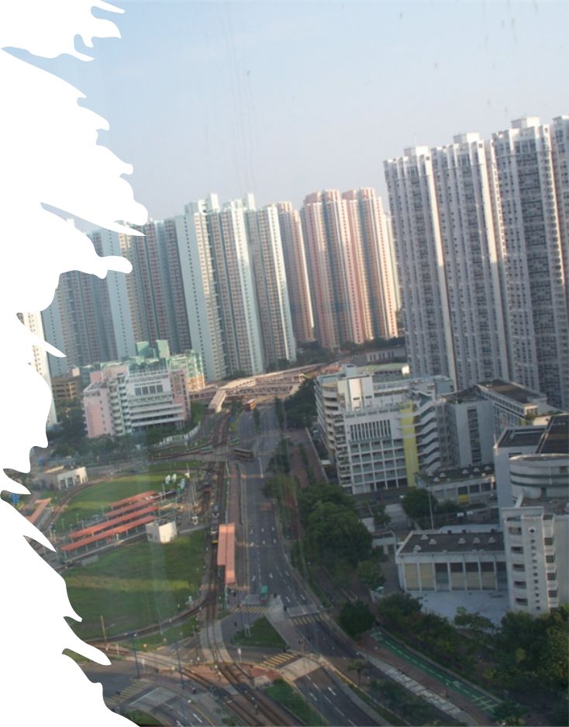
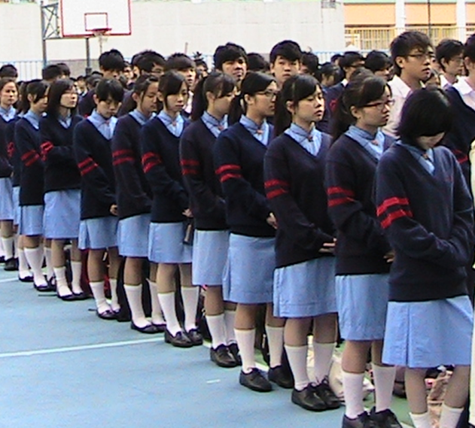
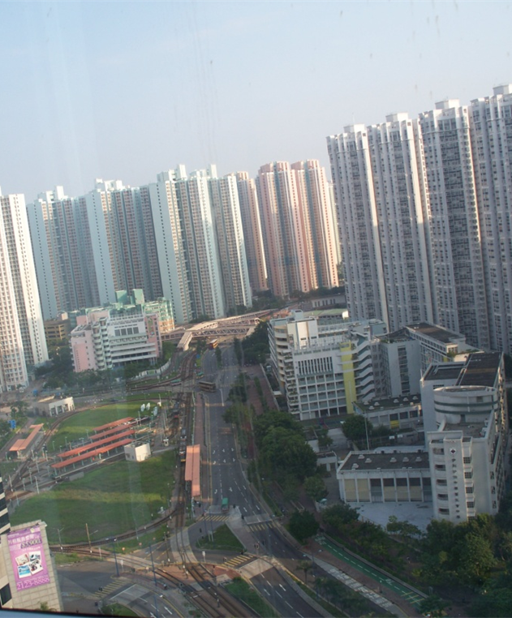

Slide 18
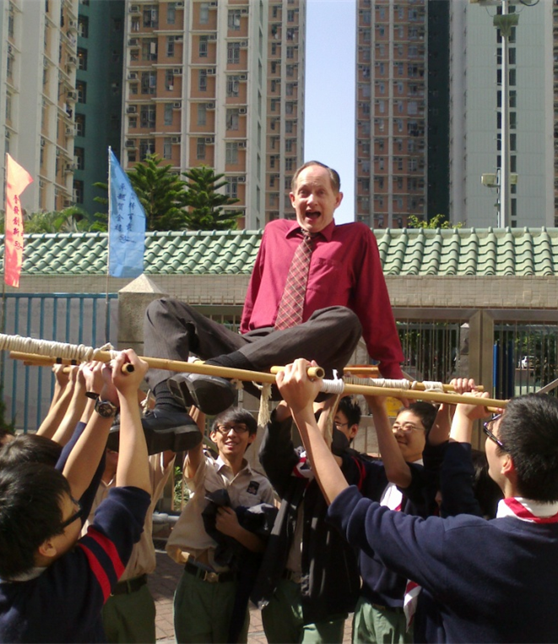
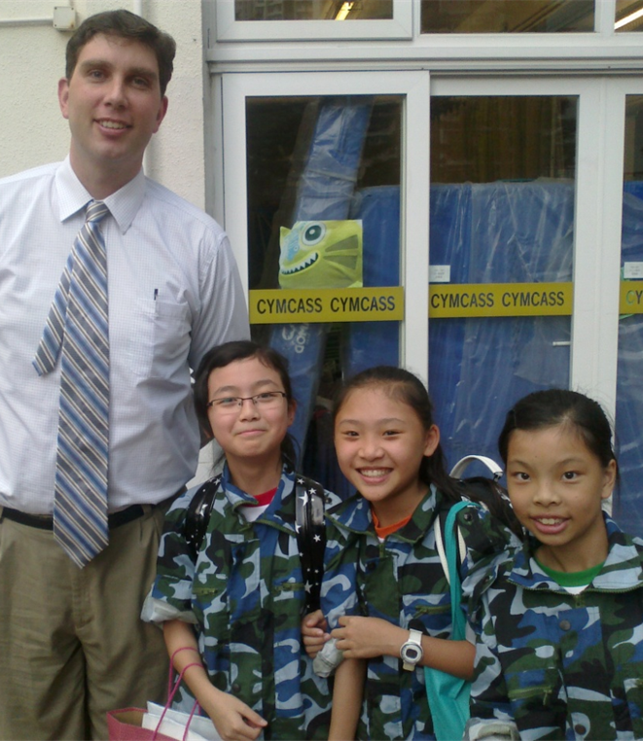

Slide 20
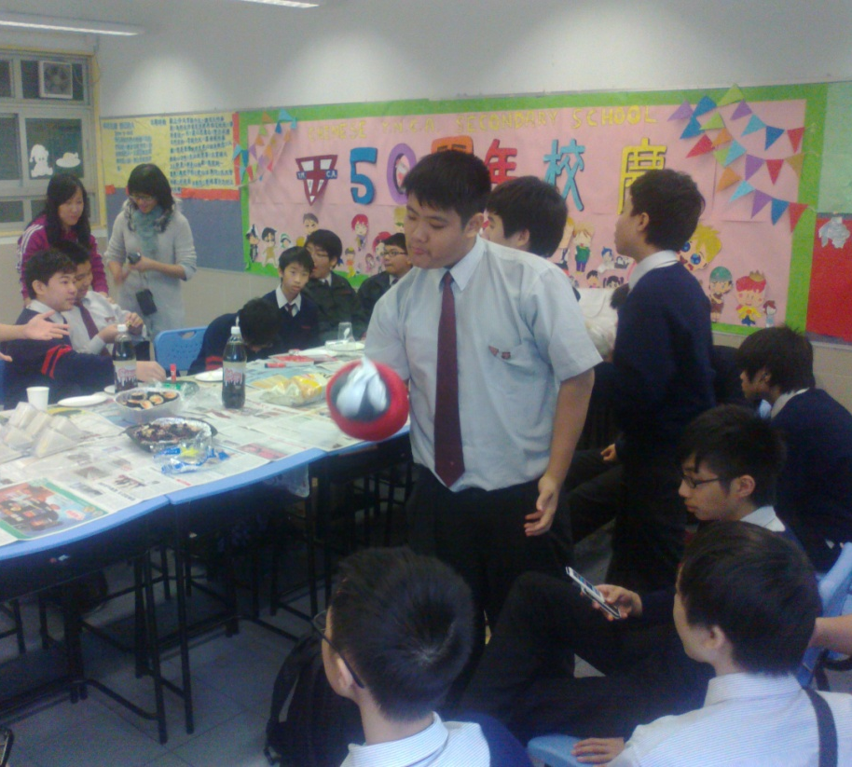
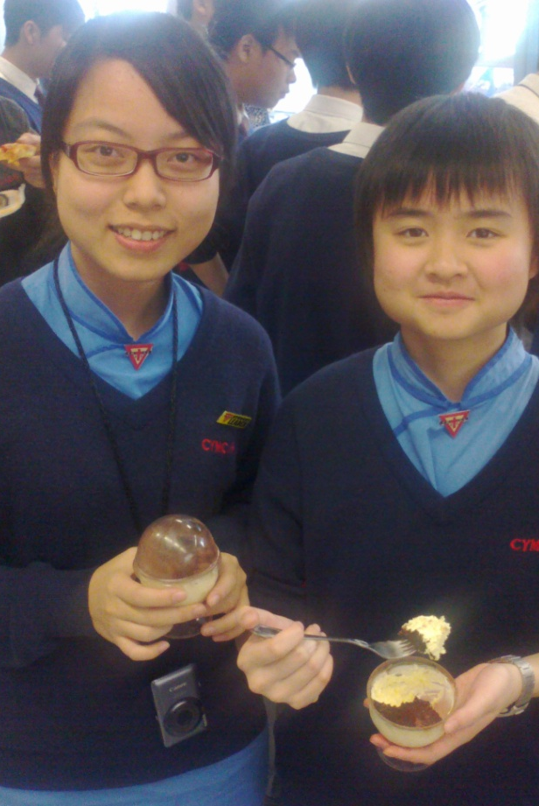

Slide 22
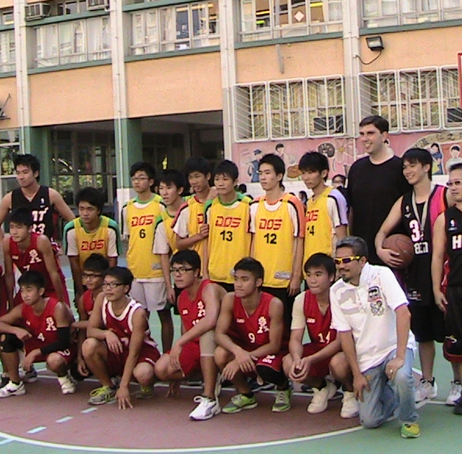
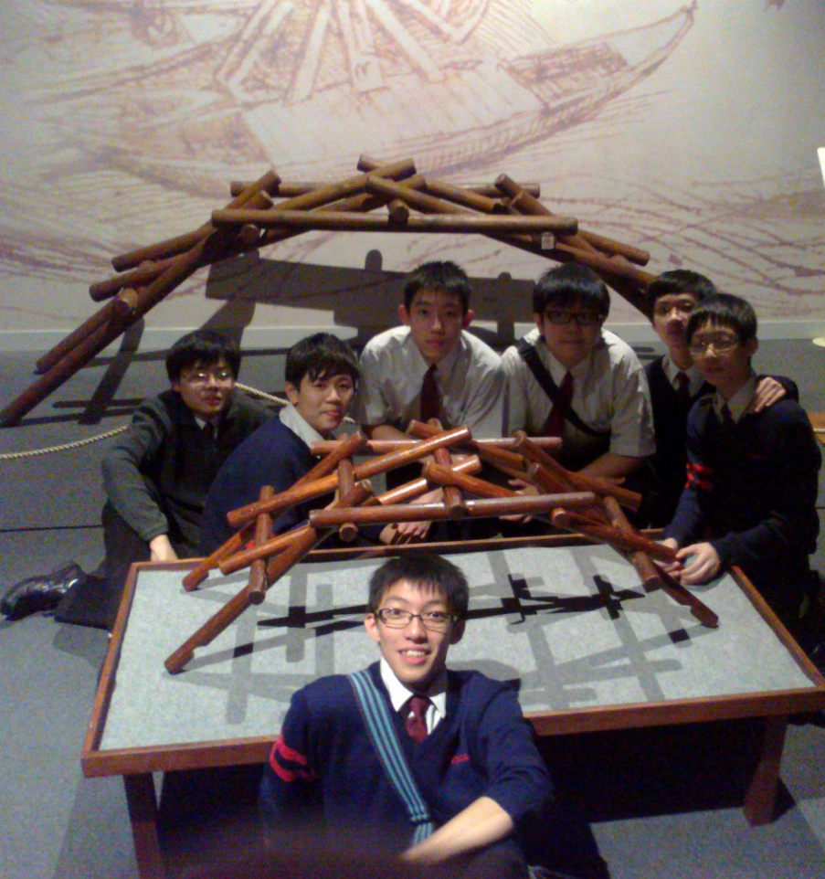

Slide 24
