Slide 1
The following PowerPoint is taken from a junior camp sermon series by Bob Roberts preached at the Wilds Christian Camp during the summer of 2022.
Find full Bible study posts from this series and more resources at reflectingthedesigner.com.
Email questions to info@reflectingthedesigner.com

Slide 2
Miracle #2
Healing the Official’s Son from Afar
John 4:46-54

Slide 3
John 4:46-54

Slide 4
John 4
46) So Jesus came again into Cana of Galilee, where he made the water wine. And there was a certain nobleman, whose son was sick at Capernaum.
This man was desperate for help because his son was sick to the point of dying. And as a parent, I feel his desperation and need!

Slide 5
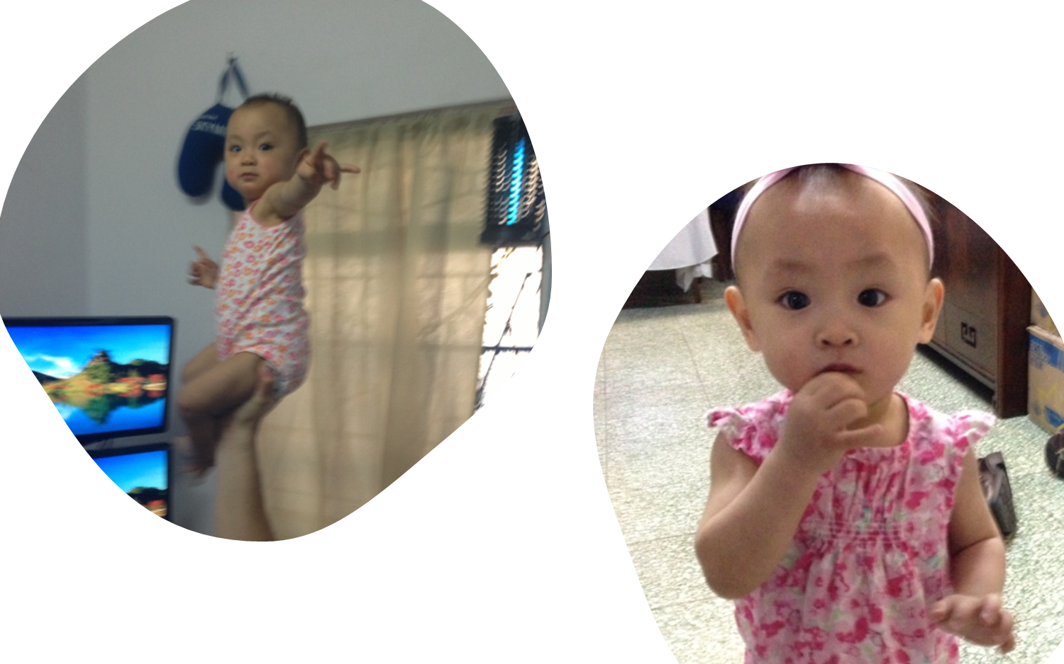

Slide 6
John 4
46) So Jesus came again into Cana of Galilee, where he made the water wine. And there was a certain nobleman, whose son was sick at Capernaum.
47) When he heard that Jesus was come out of Judaea into Galilee, he went unto him, and besought him that he would come down, and heal his son: for he was at the point of death.

Slide 8
John 4
48) Then said Jesus unto him, Except ye see signs and wonders, ye will not believe.
Last verse in the Gospel of John: And there are also many other things which Jesus did, the which, if they should be written every one, I suppose that even the world itself could not contain the books that should be written. Amen. (John 21:25 )

Slide 9
John 4
49) The nobleman saith unto him, Sir, come down ere my child die.
50) Jesus saith unto him, Go thy way; thy son liveth. And the man believed the word that Jesus had spoken unto him, and he went his way.

Slide 10
John 4
51) And as he was now going down, his servants met him, and told him, saying, Thy son liveth.
52) Then enquired he of them the hour when he began to amend. And they said unto him, Yesterday at the seventh hour [1:00pm] the fever left him.
53) So the father knew that it was at the same hour, in the which Jesus said unto him, Thy son liveth: and himself believed, and his whole house.

Slide 11
John 4
It looks like the father waited until the next day to go home! What a hearty, bold kind of faith! We can desire this kind of faith and pray for it!
But it is not the amount or intensity of the faith that ultimately matters, it is what the faith is in that ultimately matters!

Slide 13
What Do You Believe?
The most important thing about us is what we think about God. (Tozer)
But the most important thing ever is what God thinks about us! (Lewis)
What are you trusting in today for peace, joy, satisfaction, forgiveness of sins, and hope of eternal life? Is your faith pointed at something or someone? What is the object of your hope?

Slide 14
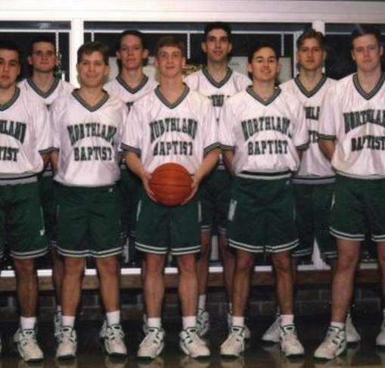
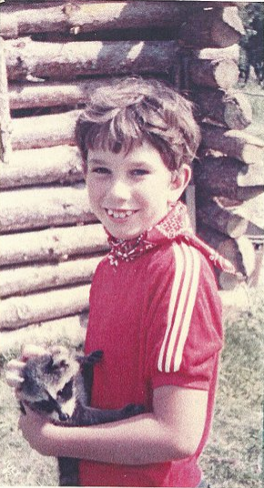

Slide 16
The True Test of Faith
Sincerity is not the test of faith. Jesus is the Test of Faith. Are you Trusting in Him Alone?
And this is life eternal, that they might know thee the only true God, and Jesus Christ, whom thou hast sent. (John 17:3)
Jesus saith unto him, I am the way, the truth, and the life: no man cometh unto the Father, but by me. (John 14:6)
For God so loved the world, that he gave his only begotten Son, that whosoever believeth in him should not perish, but have everlasting life. (John 3:16)

