Slide 1
The following PowerPoint is taken from a junior camp sermon series by Bob Roberts preached at the Wilds Christian Camp during the summer of 2022.
Find full Bible study posts from this series and more resources at reflectingthedesigner.com.
Email questions to info@reflectingthedesigner.com

Slide 2
Miracle #1
Jesus Turns Water into Wine
John 2:1-11

Slide 3
John 2:1-12

Slide 4
Quick Review
John is a book of SIGNS
There are 3 sets of 7 SIGNS
Seven Witnesses
Seven “I AM” Statements
Seven Miracles
John told us why he wrote this to you and me: “But these are written so that you may believe that Jesus is the Christ, the Son of God, and that by believing you may have life in his name.” (John 20:31)
Tonight, we come to the first recorded miracle of Jesus!

Slide 5
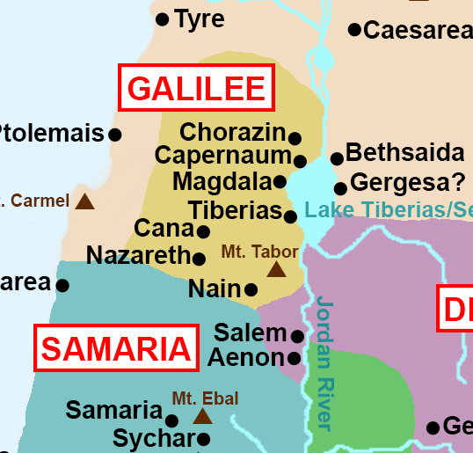
John 2
1) And the third day there was a marriage in Cana of Galilee; and the mother of Jesus was there.

Slide 6
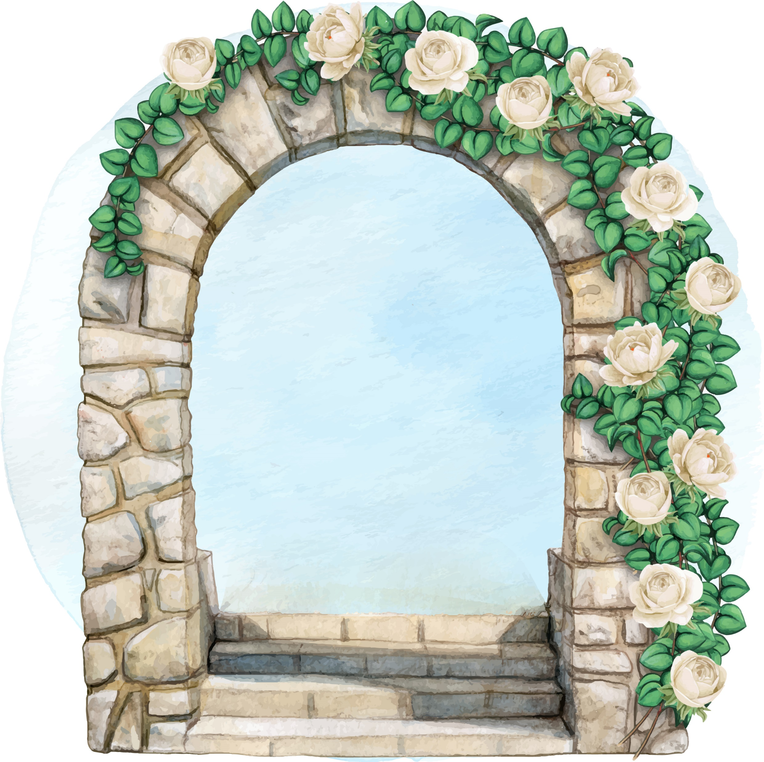
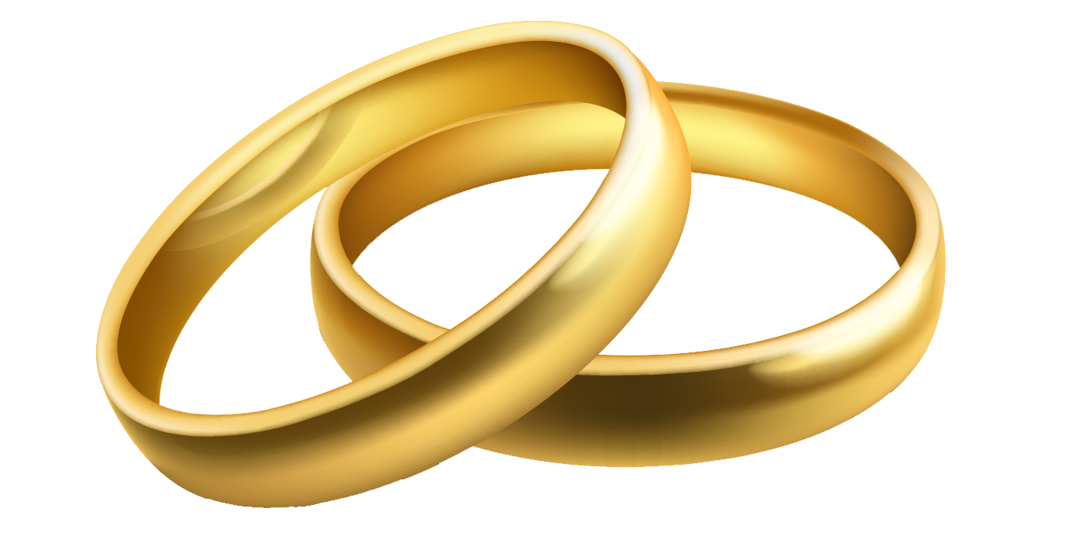

Slide 7
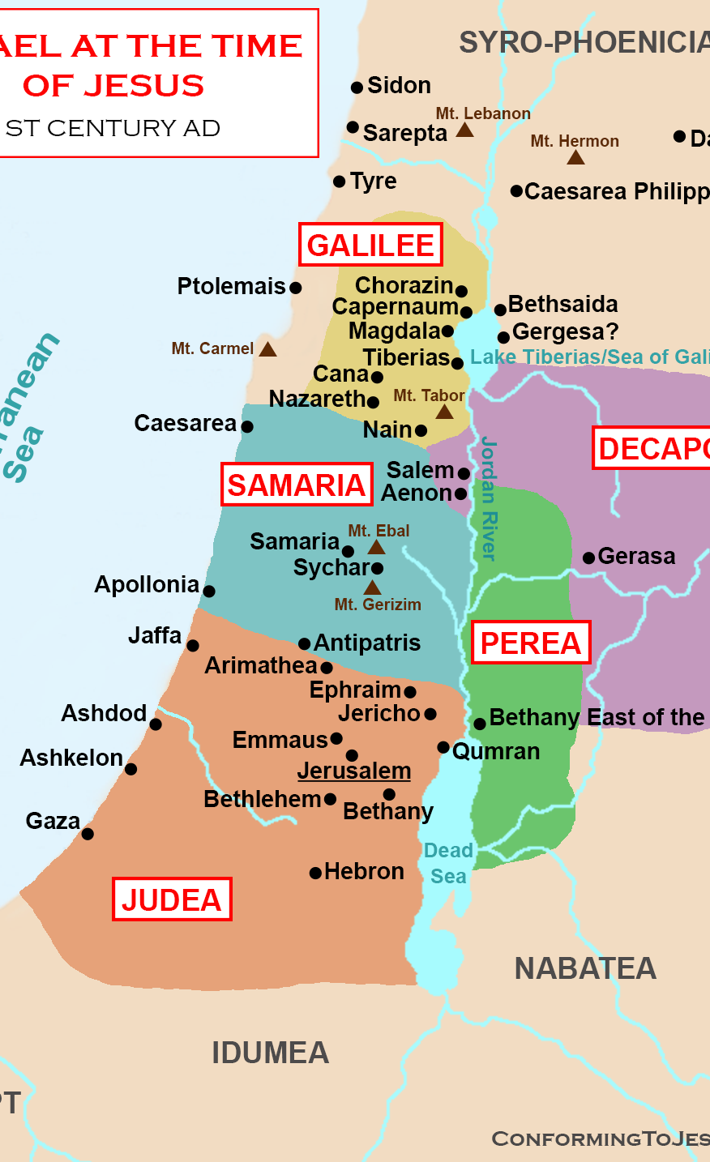
John 2
1) And the third day there was a marriage in Cana of Galilee; and the mother of Jesus was there
2) And both Jesus was called, and his disciples, to the marriage.

Slide 10
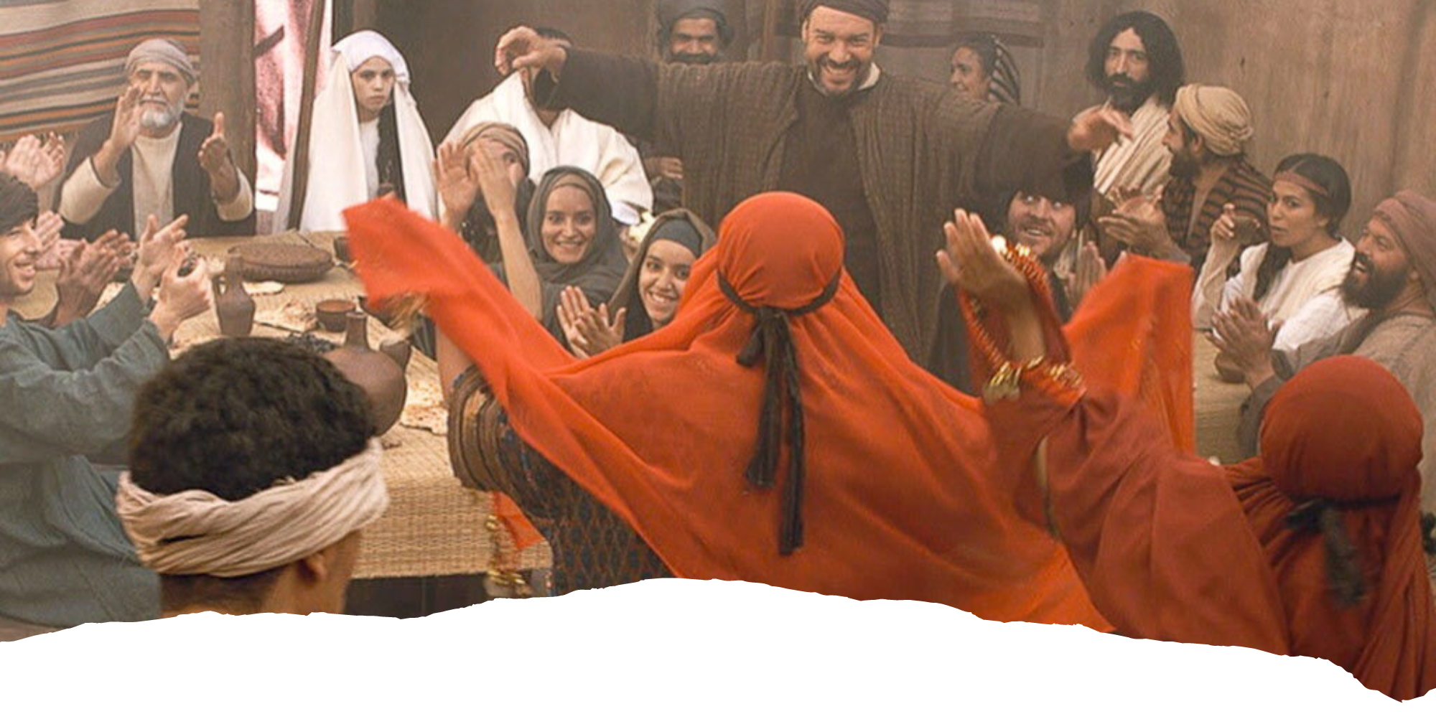
A wedding celebration
lasted for an entire week!

Slide 11
John 2
3) And when they wanted wine, the mother of Jesus saith unto him, They have no wine.
Wine is used throughout Scripture (both Old and New Testaments) to represent happiness and fulness and abundance. [study idea: look up all the verses where “wine” appears]
Weddings lasted seven days, and hosts invited as many people as possible, especially distinguished guests like prominent teachers. To run out of wine at a wedding was a social disaster that would become the subject of jests for years; the host was responsible to provide his guests with adequate wine for seven days. In this case the host would be the bridegroom! The husband-to-be!

Slide 12
John 2
4) Jesus saith unto her, Woman, what have I to do with thee? mine hour is not yet come.
Is Jesus being rude? No. He is being God. He is addressing her in a way that could abruptly arrest her (and us) to the fact that He is here on a mission, and that even though Mary is His earthly mother, Jesus’ ultimate goal is to redeem sinful Mary along with the rest of sinful humanity.
Whenever Jesus’ “Hour” is used in John’s Gospel it is referencing the event of the CROSS.
So Jesus is likely indicating to Mary this: “Once I begin doing miracles, I begin the road to the CROSS.”

Slide 13
Another Key Verse in John
The next day John [the Baptist] seeth Jesus coming unto him, and saith, “Behold the Lamb of God, which taketh away the sin of the world.” (John 1:29)

Slide 14
John 2
5) His mother saith unto the servants, Whatsoever he saith unto you, do it.
6) And there were set there six waterpots of stone, after the manner of the purifying of the Jews, containing two or three firkins apiece. [20-30 gallons apiece]
7) Jesus saith unto them, Fill the waterpots with water. And they filled them up to the brim.
8) And he saith unto them, Draw out now, and bear unto the governor of the feast. And they bare it.

Slide 15
John 2
9) When the ruler of the feast had tasted the water that was made wine, and knew not whence it was: (but the servants which drew the water knew;) the governor of the feast called the bridegroom,
10) And saith unto him, Every man at the beginning doth set forth good wine; and when men have well drunk, then that which is worse: but thou hast kept the good wine until now.

Slide 16
What a miracle it was!
Dr. Cliff Lewis explains: “At a molecular level, the water, basically hydrogen and oxygen, was changed into wine that contains sugars, yeast, and water, which contain carbon and nitrogen along with oxygen and hydrogen. Thus, by changing water into wine Jesus demonstrated his authority over even the atomic structure of atoms by commanding oxygen and hydrogen atoms to disassemble and reform into other atoms of different configurations. The amount of energy it would take to perform this atomic deconstruction and reconstruction is staggering. This intermolecular energy being released is the source of the explosive energy from an atomic bomb. However, since Jesus caused the wine atoms to come back together, he would have to put this astronomical amount of energy into the atoms in order to have them reconstruct. To do so without any visible energy transformation of the liquid indicates a mastery of natural law far beyond our current comprehension. And he accomplished it with no physical exertion.”

Slide 17
Correlation to Moses
Correlation with Moses? What was Moses’ first sign?
Jesus is the bridegroom. His Church is the bride. Husbands, love your wives, as Christ loved the church and gave himself up for her. (Eph. 5:25)
At the last supper, the wine represents the blood of Jesus that cleanses us inside.
Wine represents abundance and blessing and celebration. The coming of Christ and the beginning of His ministry are filled with blessing and joy!

Slide 18
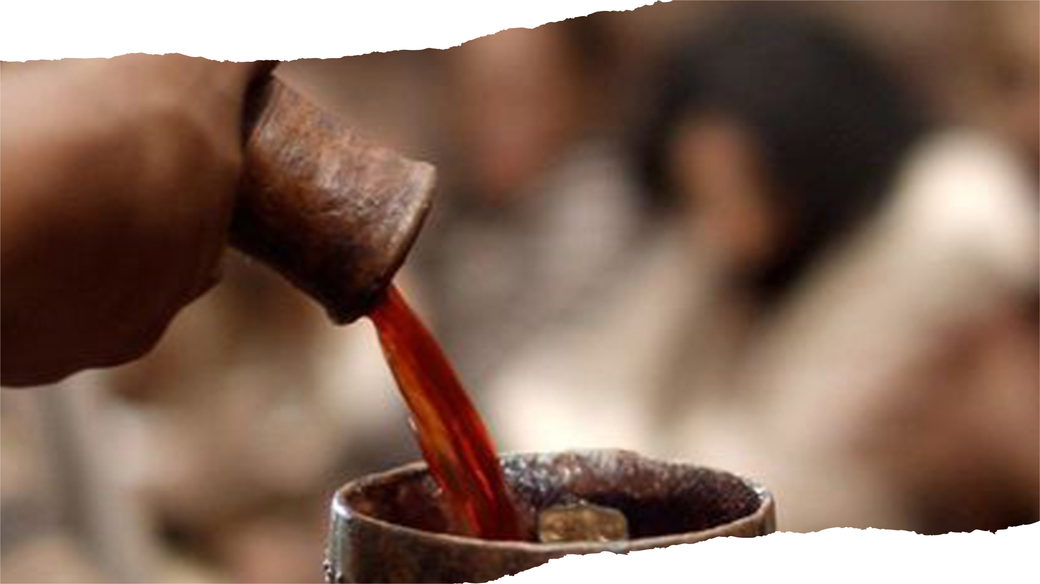
Preventing and Providing
Jesus’ first miracle of turning water into wine:
Prevented: SHAME
Provided: JOY & SATISFACTION

Slide 19
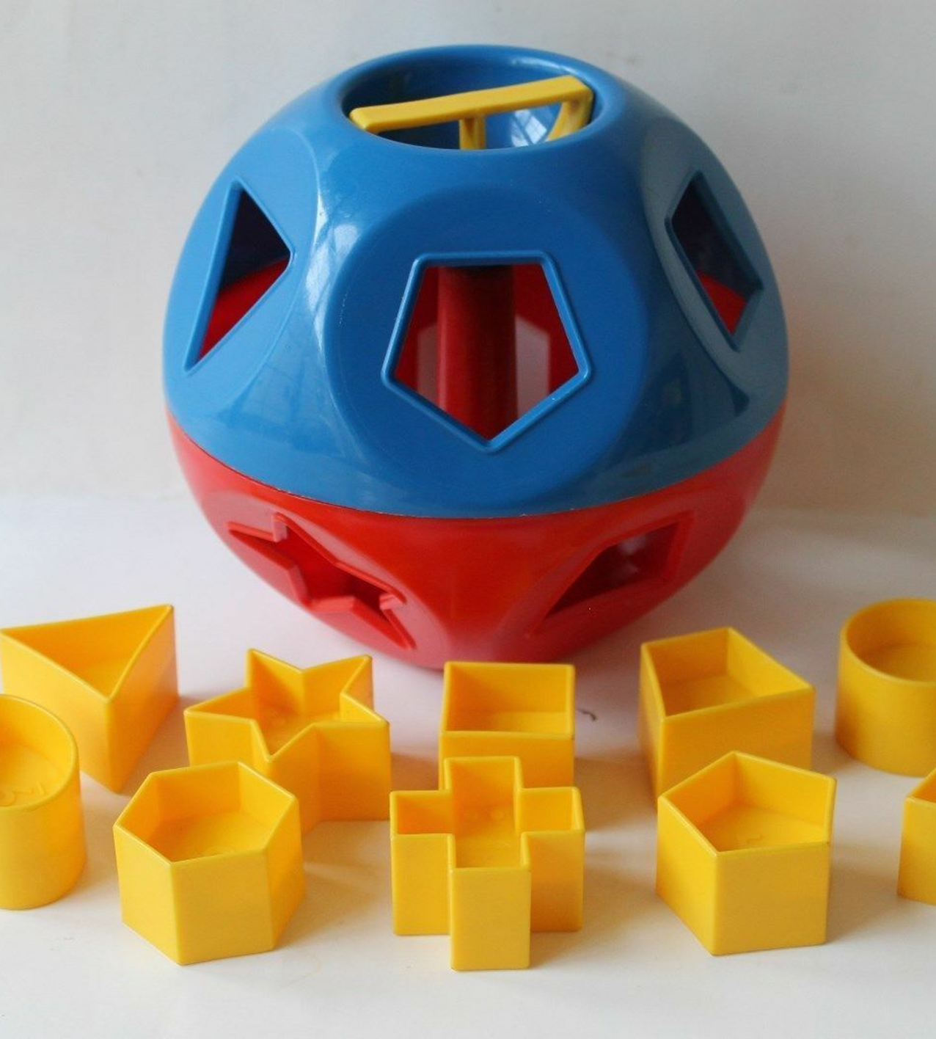
Jesus Provides JOY
Thou wilt shew me the path of life: in thy presence is fulness of joy; at thy right hand there are pleasures for evermore. (Psalm 16:11)

Slide 20
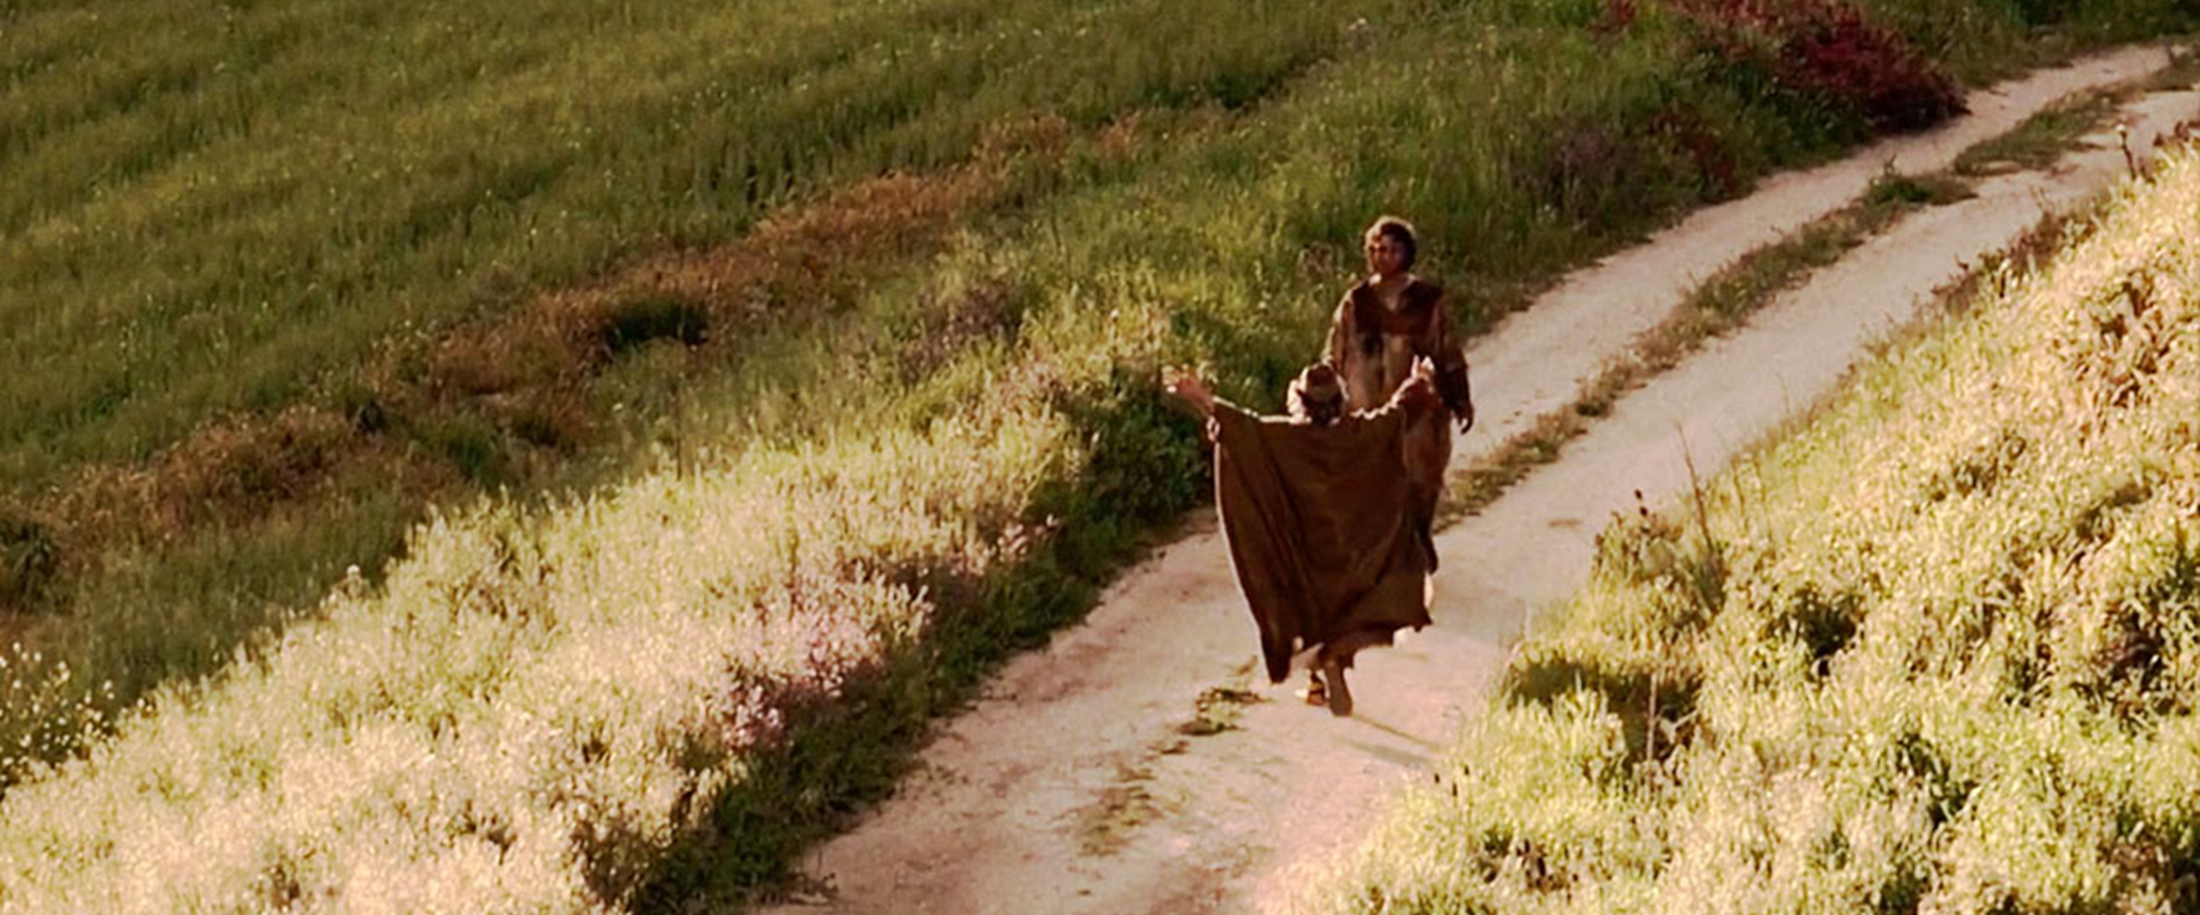
Jesus Prevents SHAME
And he arose, and came to his father. But when he was yet a great way off, his father saw him, and had compassion, and ran, and fell on his neck, and kissed him. (Luke 15:20)

