Slide 1
The following PowerPoint is taken from a junior camp sermon series by Bob Roberts preached at the Wilds Christian Camp during the summer of 2022.
Find full Bible study posts from this series and more resources at reflectingthedesigner.com.
Email questions to info@reflectingthedesigner.com

Slide 2
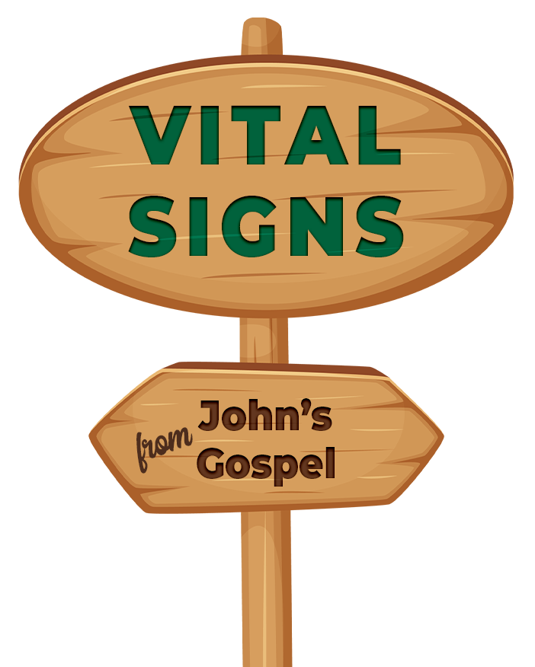

Slide 3
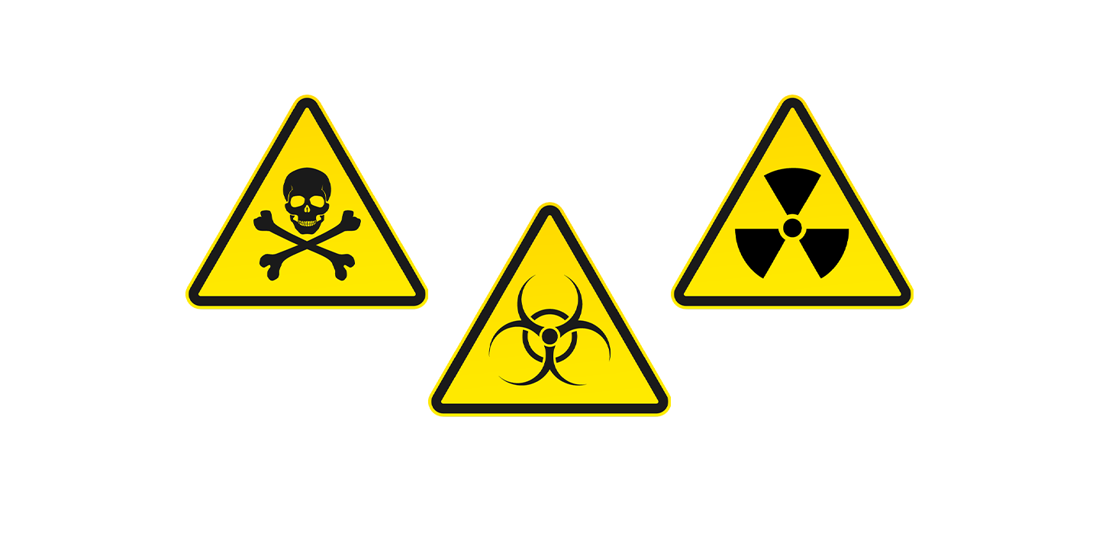

Slide 5
YUMMMMM

Slide 7
The Purpose of a Sign
A sign wants you to believe something and act accordingly!
But the signs in the book of John are personal living signs. God’s Word is alive, and it is speaking to YOU!

Slide 8
“That’s so Meta!”
“Meta” is something that refers to itself and seems to have an awareness of itself. (i.e. “fourth wall”)
“Meta” can also mean something that is mysteriously “above” or “beyond.”
Metaverse
Metaphysics
Metamorph0sis

Slide 9
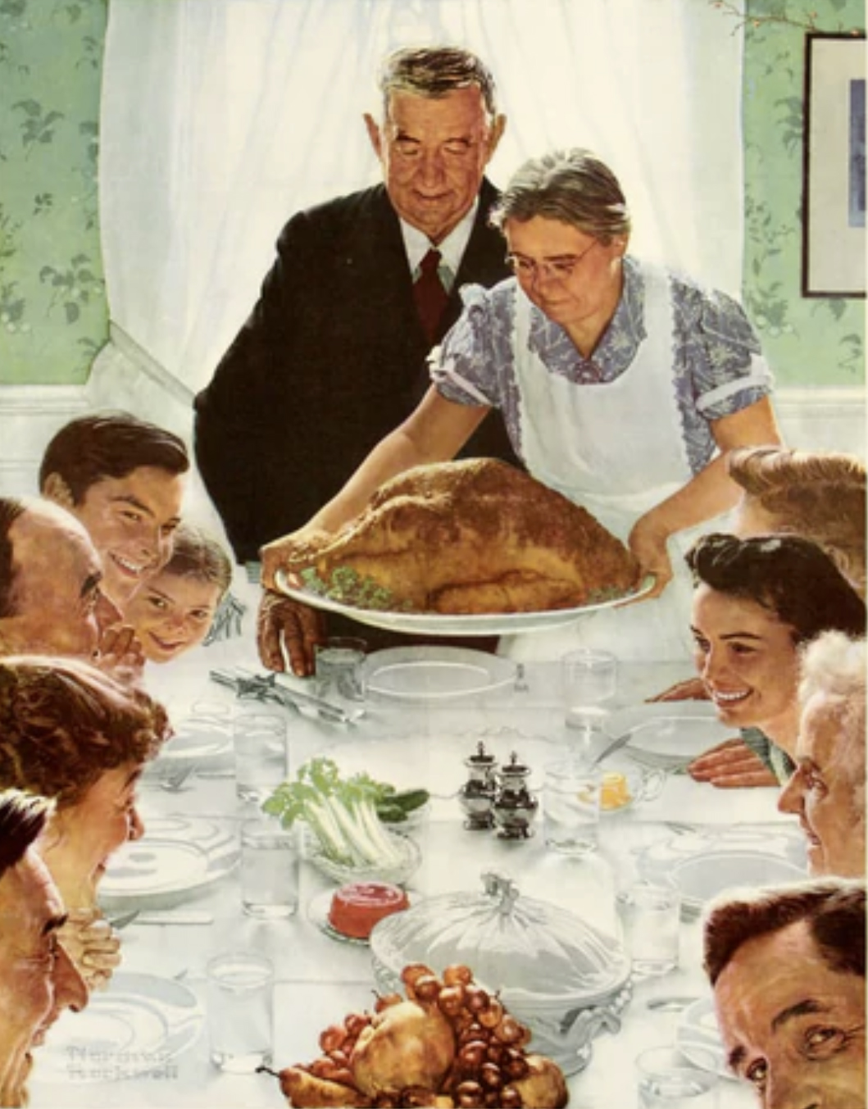
Meta in Artwork

Slide 10
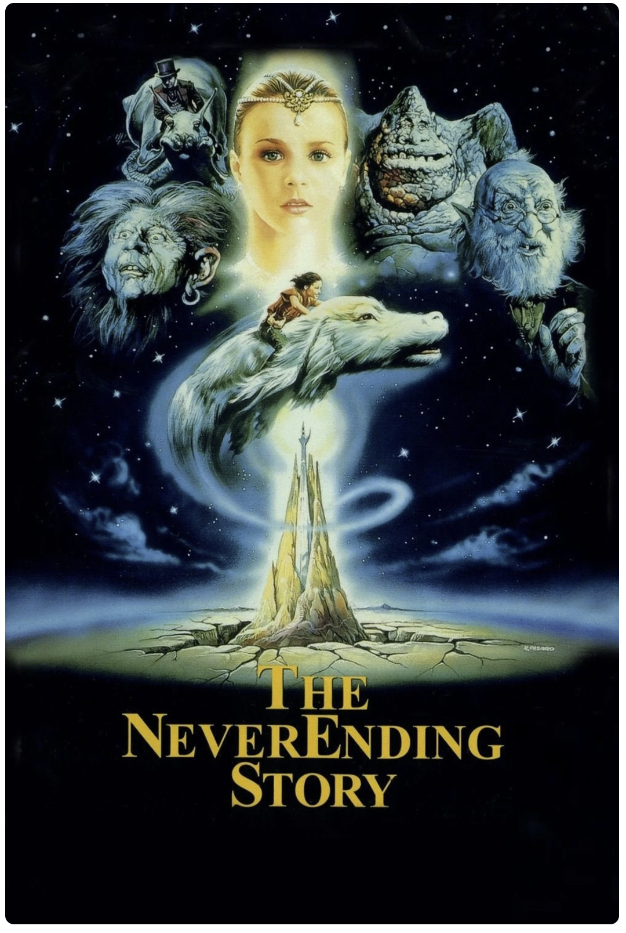
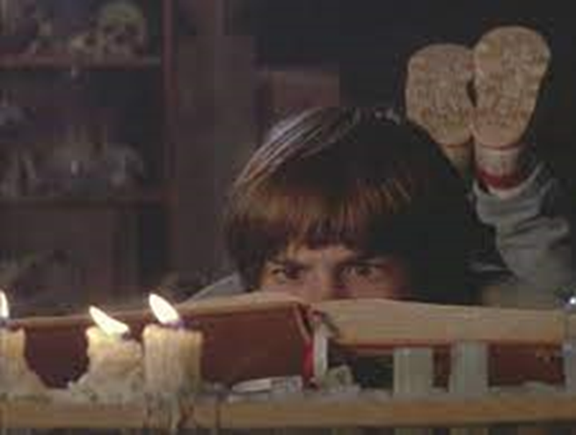
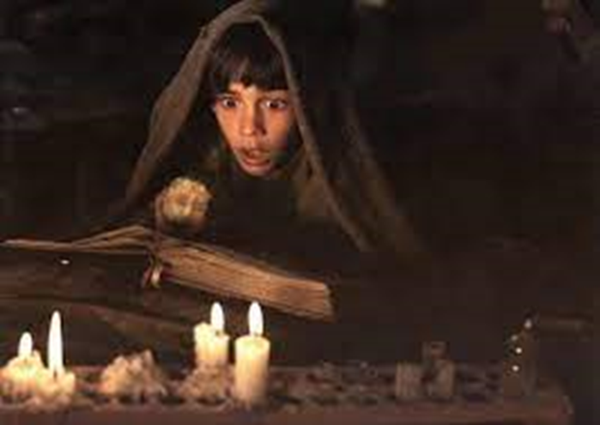
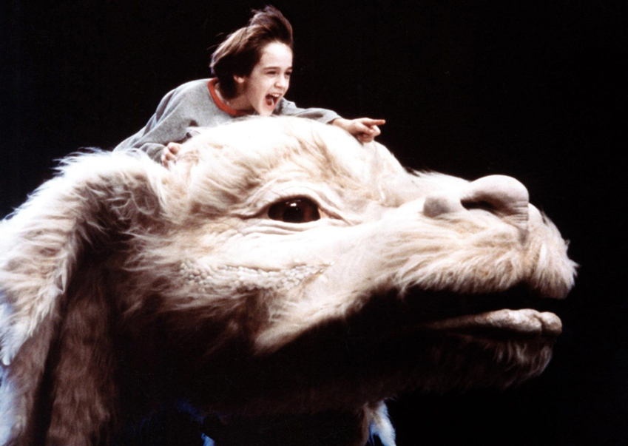
Meta in Film: The Never Ending Story

Slide 11
Meta in the Bible John 20
26) Eight days later, his disciples were inside again, and Thomas was with them. Although the doors were locked, Jesus came and stood among them and said, “Peace be with you.”
27) Then he said to Thomas, “Put your finger here, and see my hands; and put out your hand, and place it in my side. Do not disbelieve, but believe.”
28) Thomas answered him, “My Lord and my God!”

Slide 12
Meta in the Bible John 20
29) Jesus said to him, “Have you believed because you have seen me? Blessed are those who have not seen and yet have believed.”
30) Now Jesus did many other signs in the presence of the disciples, which are not written in this book;
31) but these are written so that you may believe that Jesus is the Christ, the Son of God, and that by believing you may have life in his name.

Slide 13
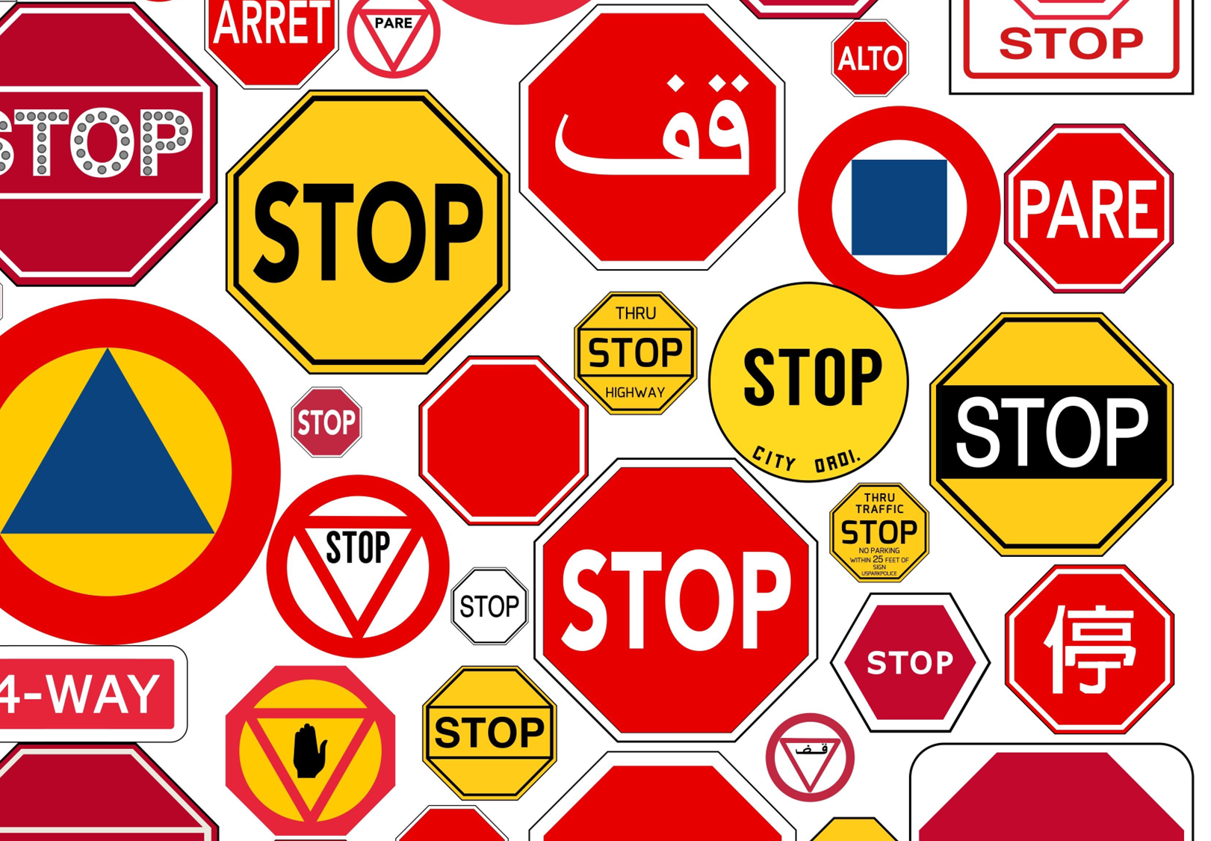

Slide 14
John’s Gospel is filled with vital signs that all have the same message.
John is a book of “signs” that point to one primary truth: that Jesus Christ is the fully divine Son of God and the only way to eternal life.
John gives us 3 sets of 7 signs… (that’s a whole lotta signs!)
These are the most important signs ever because how you respond to these signs impacts your soul forever.

Slide 15
7 WITNESSES
1. John the Baptist (John 1:34) “This is the Chosen One of God.”
2. Nathanial (John 1:49) “You are the Son of God.”
3. Peter (John 6:69) “You are the Holy One of God.”
4. Martha (John 11:27) “You are the Christ, the Son of God.”
5. Thomas (John 20:28) “My Lord and my God.”
6. John (John 20:31) “Jesus is the Christ, the Son of God.”
7. Jesus (John 10:36) “I am the Son of God.”

Slide 16
7 “I AM” Statements
I Am the Bread of Life (John 6:35-48)
I Am the Light of the World (John 8:12; 9:5)
I Am the Good Shepherd (John 10)
I Am the Gate (John 10:7)
I Am the Resurrection & the Life (John 11:25)
I Am the Way, the Truth, & the Life (John 14:6)
I Am the True Vine (John 15)

Slide 17
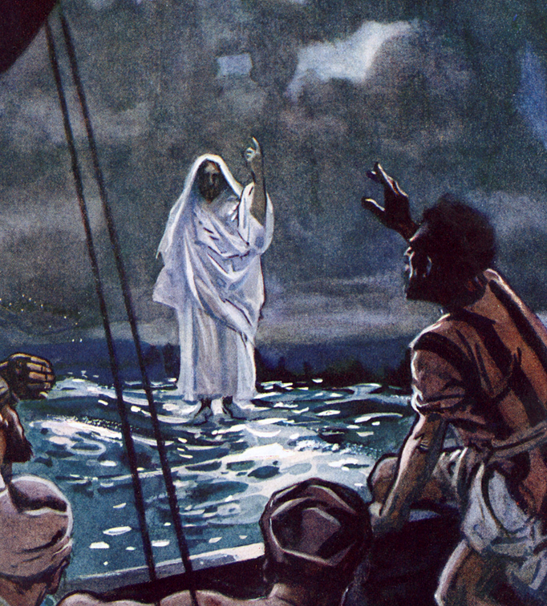
7 Miracles

Slide 18
3 Sets of 7 Signs (21 Vital Signs)
7 Witnesses 7 “I AM” Statements 7 Miracles
This week at camp we are going to focus on the 7 miracles of Jesus! Why?
But these are written so that you may believe that Jesus is the Christ, the Son of God, and that by believing you may have life in his name. (John 20:31 )

Slide 19
The signs are recorded so that you might BELIEVE!
The 3 C’s of Faith
Creed (facts/doctrine )
Commitment
Continuation
PRESENT CONTINUING … But these are written so that you may KEEP ON believing that Jesus is the Christ, the Son of God, and that by continuing to believe you may KEEP ON having life in his name.

Slide 20
Camp Goal:
That unbelievers would become believers. And that believers would keep on believing!

Slide 21
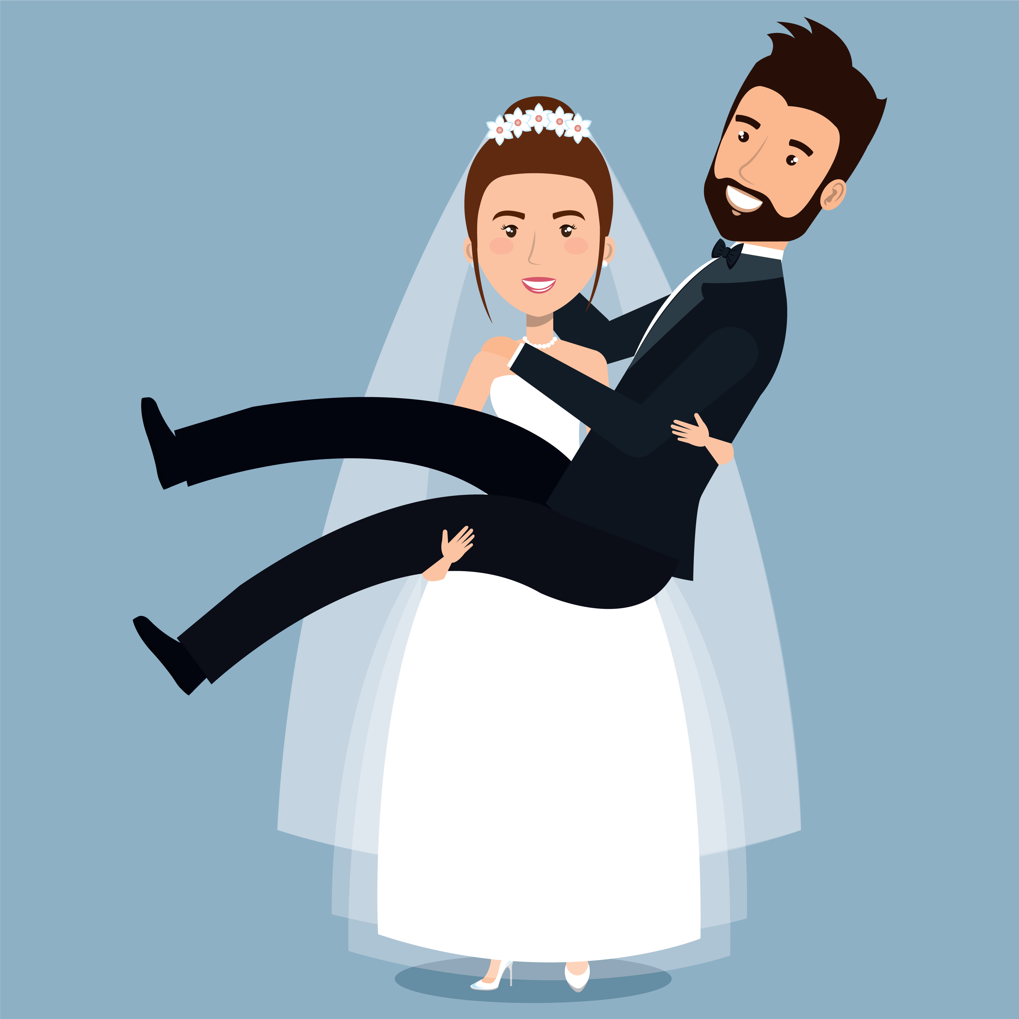
Tomorrow is Tuesday…
Tomorrow morning, we are going to learn all 7 miracles in a super cool memorable way that you can share with your friends!
Tomorrow night we are going to have a wedding to help us celebrate Jesus’ first recorded miracle.

